Slide 1

Learning Strand 1
Become an Agent of Inclusion through
Language and
Communication

Slide 2
In this lesson, you will learn:
1.1 The importance of language in adult refugee integration
1.2 Tools to help you teach and encourage language learning
1.3 Collaborating for language teaching success – key country contacts and resources
2.1 Communicating with adults who speak a different language
2.2 Spotlight on Non-Verbal Communication
2.3 Communicating with Empathy
2.4 Technology – a New and Innovative means of Communication
LANGUAGE
COMMUNICATION
Learning Legend:
This project has been funded with support from the European Commission. This publication reflects the views only of the author, and the Commission cannot be held responsible for any use, which may be made of the information contained therein.
DOWNLOADS
USEFUL TOOL
GOOD PRACTICE

Slide 3
1. LANGUAGE
IN THIS SECTION:
1.1 The importance of language in adult refugee and migrant integration
Language has a key role to play in the integration of adult refugees and migrants.
Language learning environments can offer safe spaces for refugees to tell stories and any traumas they may have encountered.
Learn about the importance of language learning from a refugee and migrant perspective as well as the importance of preserving home languages

Slide 4
“Without language, one cannot talk to people and understand them; one cannot share their hopes and aspirations, grasp their history, appreciate their poetry, or savor their songs.”
- Nelson Mandela

Slide 5
How does Language Learning promote Integration ?
Language learning promotes inclusion and non-discrimination. It allows refugee communities to come together with their host communities, strengthening the society of which they are all part. It allows migrants to thrive in their new environment.
A shared language increases refugee integration and helps refugees to become self-sufficient and make valuable contributions to their local community. Language has a central role to play in helping refugees to address the effects of loss, displacement and trauma.
Language proficiency is known to accelerate integration. For adult migrants, the time spent learning the language of the host community provides an excellent opportunity to begin the process of integration into a new culture and society
Source: https://www.britishcouncil.org/language-for-resilience
and https://rm.coe.int/16802fc1c7

Slide 6

“When I came to Ireland I didn’t speak English. I used to just answer all questions with “yes, yes, yes” but I didn’t understand anything, I just wanted to escape.”
Rodica Lunca is Roma and came to Ireland from Romania in 2001. Understanding the impact of language barriers, Rodica now works as a cultural mediator between members of the Roma community in Ireland and the various institutions of the State they encounter in day-to-day life.
Source: http://www.irishexaminer.com/ireland/integrating-the-roma-41506.html http://www.irishtimes.com/news/health/mediating-between-cultures-1.609199

Slide 7

“In first grade I didn't know the language well, so I didn't communicate much. I had a friend from the same country in my own class who helped me. So I learned italian quickly. (...) I arrived with my mom. It was hard for her, because it's easier for kids to learn in the end. ”
«Ragazzi immigrati. L'esperienza scolastica degli adolescenti attraverso l'intervista biografica» P. D’Ignazi
Source: https://books.google.it/books?id=sYqXCgAAQBAJ&pg=PA162&lpg=PA162&dq=testimonianze+di+migranti+che+hanno+imparato+la+lingua+italiana&source=bl&ots=dYDfyGqLid&sig=ACfU3U0LSwA0QOAJEI3YDtV_IRdVTNQNiA&hl=it&sa=X&ved=2ahUKEwiWrb76--7nAhVChlwKHU6ZDggQ6AEwCXoECAoQAQ#v=onepage&q=testimonianze%20di%20migranti%20che%20hanno%20imparato%20la%20lingua%20italiana&f=false

Slide 8
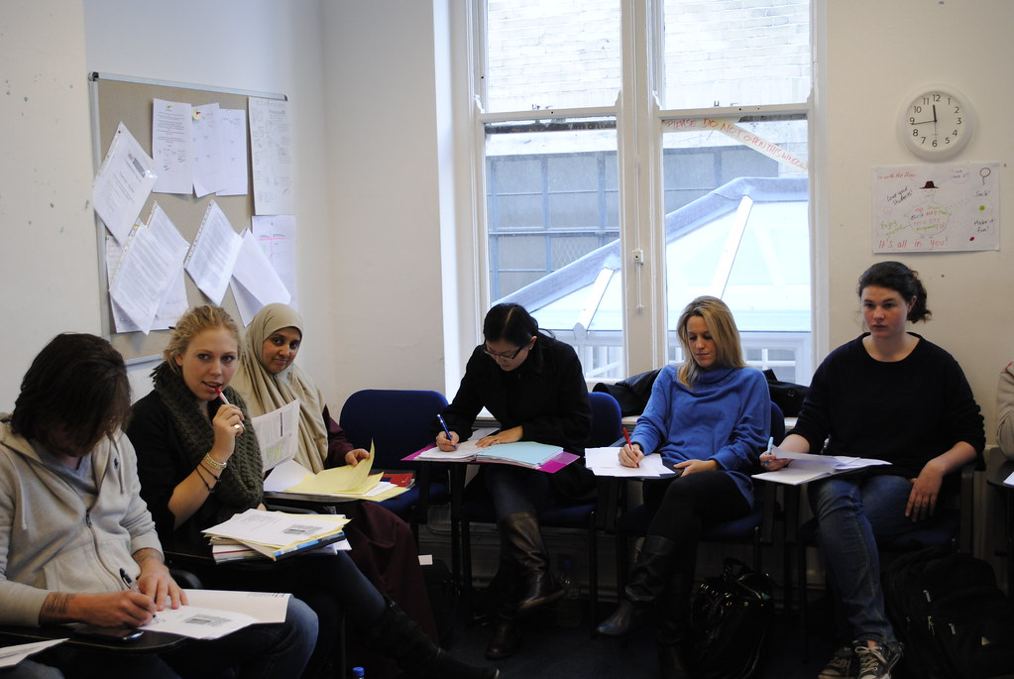
Language classes offer a safe place to talk
Language classes have a multitude of benefits for refugees and migrants.
A language class gives them the opportunity to tell their story. They can discuss something that has happened in the third person or role plays. These techniques allow people to tell their stories and describe emotions without feeling as vulnerable.

Slide 9

The importance of Language Learning from a refugee perspective
Featuring: Israa Ahmad Ghoneim, Syrian mother
Source: https://www.youtube.com/watch?time_continue=138&v=j-MAq5esf4c&feature=emb_logo

Slide 10

The importance of Language Learning from a refugee perspective
"I came to Italy in 2000 with the intention of finishing my university studies that I had started in Morocco. As I did not know Italian, I became discouraged from enrolling at university and so I took a job at a restaurant as dishwasher. Luckily, I did not have to talk a lot. At the same time I enrolled in the Italian language course at the University for Foreigners in Perugia.
Now I'm a cook and I speak Italian very well. I have a regular job that I like, but I confess that I feel a bit nostalgic about not graduating in Engineering. Maybe if I had studied Italian before coming to Italy or if I had started attending a language course as soon as I arrived, my professional career would have a greater value.”
Layla Habchane is a Moroccan Migrant who moved to Italy in 2000
Layla highlights that early language acquisition is key

Slide 11
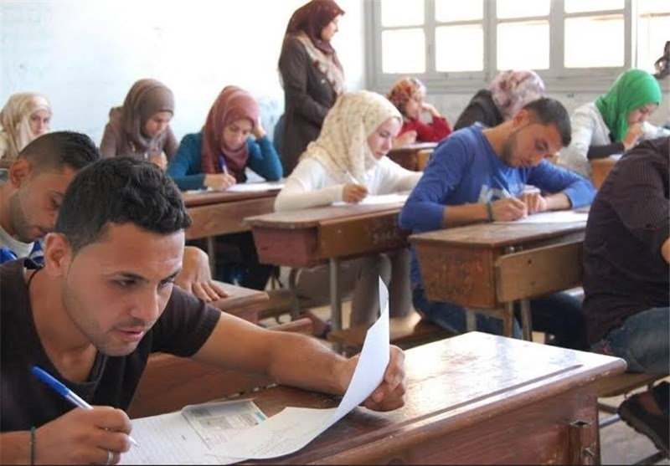
What do refugees want in terms of language learning?
“They want to learn English to communicate, and to talk about their experience.
They want to feel like they are moving forward towards something, and that they are valued, that their culture and language are valued, and they are valued as people.”
Source: https://www.britishcouncil.org/voices-magazine/can-learning-languages-help-refugees-cope

Slide 12

But…
Language acquisition is not always easy.
For some refugees and migrants, the interlinking of language and integration leave some in a state of limbo as they struggle to reconcile their own backgrounds with the desire to feel included in their new host society.
“Without adequate English, job and educational/training prospects, friendships, access to accurate and reliable information and the establishment of trust and ‘real’ communication were severely limited”.
Source Doras DCU

Slide 13
“Language is an equalizer. When a child can speak and write in the host country language, they develop the confidence and self-assurance to communicate with their peers, building a solid educational foundation that serves them for the rest of their lives.”
- Amin Awad, UNHCR Middle East and North Africa Bureau, Regional Refugee Co-ordinator for the Syria and Iraq Situations

Slide 14

The importance of preserving Home Languages
While the importance of learning the host language is often cited, we must also consider the important role of the home language.
Home languages provide the language skills and literacy which are the basis for learning new languages and learning in general.
By protecting the use of refugees’ and migrants home languages, supporting their use in the home, throughout communities and through multilingual education, we can help break down the barriers to schooling and further education.
Source: https://www.britishcouncil.org/language-for-resilience

Slide 15
1. LANGUAGE
IN THIS SECTION:
1.2 Tools to help you teach and encourage language learning
Find out about a Toolkit to help you provide Language Support to Adult Refugees and other organisations you can collaborate with to provide language training
Language learning can be a fun and social exercise especially when done in a new way!

Slide 16

Resources to help you deliver Language Training to Adult Refugee Learners
LANGUAGE SUPPORT FOR ADULT REFUGEES TOOLKIT
Access 57 free tools designed to assist organisations in providing language support for adult refugees.
Throughout this Council of Europe toolkit “refugee” is understood in a broad sense and includes asylum seekers as well as refugees.
Download English Toolkit

Slide 17

USEFUL TOOL
English My Way
UK Initiative: English My Way
A resource for tutors who support and teach adults with no or low levels of English - providing free teaching resources and tools to manage classes
Launched in April 2014, Good Things Foundation developed a fresh approach to English Language Learning in partnership with The British Council and BBC Learning English.
The programme is a 24-week blended learning programme with flexibility to run all sessions over a shorter period of time which can be delivered through a mix of tutor led sessions, online learning and volunteer group activity.
Source: https://www.youtube.com/watch?v=ZN4dmdtSx5k

Slide 18

Service/Education Provider Insight
English My Way
“English My Way offers a very unique blend of learning styles, formats, platforms and delivery methods – combining all these elements into an easy to follow, interactive and immersive learning experience.”
- Vick Virdee, Training Manager, Acda Skills Training
Follow link to English My Way resources

Slide 19

Resources to help you deliver Language Training to Adult Refugee Learners
https://ec.europa.eu/programmes/erasmus-plus/resources/online-linguistic-support_en#refugees

Slide 20
USEFUL TOOL
Italian Initiative - RAI Educational
The Italian language portal is the new tool created by the Ministries of the Interior, Education, University and Research and Rai Educational to help the learning and teaching of Italian.
Two main sections: Learn Italian for adult foreigners & Navigate in Italian for CTP teachers.
The materials and tools take into account European Framework of Reference for Languages and the MIUR guidelines for Italian language literacy and learning paths
The portal has a section dedicated to civic culture and civil life which helps foreign adults to achieve and consolidate active citizenship and language learning in one place.
http://www.italiano.rai.it

Slide 21

Practice Languages in fun new ways – like through music!
Learning a new language can be very difficult with new vocabulary, pronunciation, grammar and more to tackle and understand.
Finding fun and innovative ways of including language training is a great way of overcoming these obstacles and injecting some fun into the process.
Did you know that one of the nest ways to teach language is through music?! It can help with comprehension, pronunciation, vocabulary retention and much more. See next slide for more info…

Slide 22
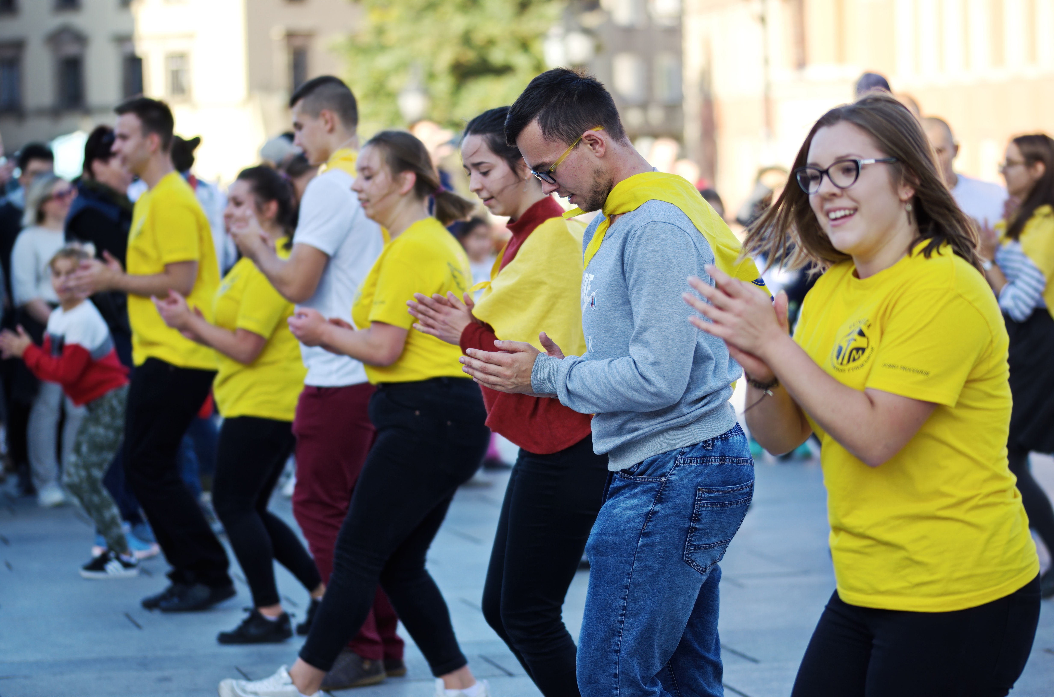







INCREASES YOUR VOCABULARY
Learning the lyrics of a song can help you learn new words. When you sing it many times, you remember these vocabularies more easily. Don’t forget, you could also learn some everyday phrases and slang
How can music help language comprehension?
WAKES UP YOUR BRAIN
Congress woman Gabrielle Giffords suffered brain damage when a bullet passed through her brain. She lost some of her speech abilities. However, listening to songs has helped her remember words she couldn’t say before. Music helped activate her memory!
BETTER COMPREHENSION
Music can help us remember the order of words and the basic structure of language. When you learn language as a whole (not just individual rules), you can understand and remember language structure better
REMEMBER WORDS AND PHRASES
It’s so hard to remember names of people but why is it easy to remember the lyrics to a song (and sometimes can’t get it out of your head)? The repetition and catchy tunes means words can stick in our mind for a long long time!
IMPROVES YOUR PRONUNCIATION
When we sign or listen to music, we pay attention to the rhythm, beat, tone, and shape of the mouth. Singing and listening to music regularly can help us improve our natural speech.
IT’S FUN!
Listening to music is not only a good way to learn, but it’s emotionally stimulating. It can uplift us. Listening to something that you like makes learning more motivating and make learning less work!
promoting refugee & migrant integration through education

Slide 23
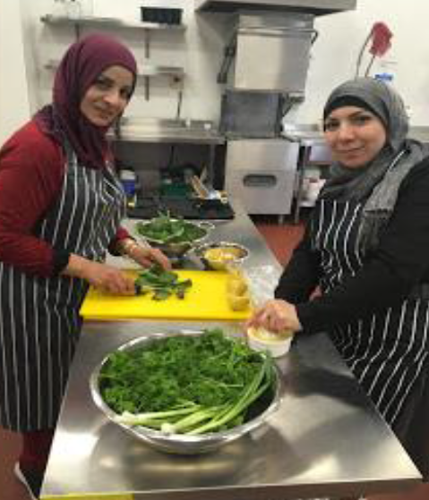
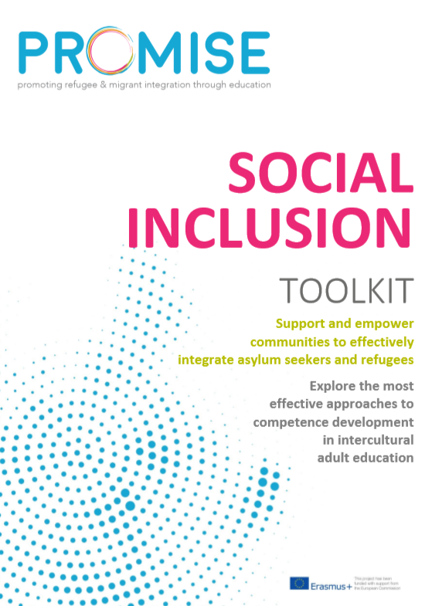
Practice Languages in new ways – Language Learning through practical workshops
GOOD PRACTICE
The Just Creative Programme which runs in the Emergency Response and Orientation Centre in Ballaghaderreen, Roscommon, Ireland provides practical language learning to coincide with training workshops Cooking & Food Preparation, Radio Broadcasting & Communications and Hairdressing & Up-styling.
This practical, real world way of learning language has had impressive results and garnered great interest among the Syrian refugee women who have taken part.
Not only have they learned new practical skills like gardening, cooking and hair dressing, where
relevant they have also learned the
English language needed in these
tasks/jobs.
For more good practices,
check out our 56 page
Promise Social Inclusion
Toolkit
DOWNLOAD HERE

Slide 24

Practice Languages in new ways – Failte Isteach Volunteer Language Programme
GOOD PRACTICE
Fáilte Isteach is an initiative of Third Age, an Irish organisation that provides opportunities for older people to contribute to their communities and engage actively in society.
Fáilte Isteach involves volunteers (tutors) welcoming migrants to the community through conversational English classes.
Tutors and students usually meet once a week and it can happen in a very informal setting where people just have a chat in English.
Source: www.thirdageireland.ie/failte-isteach

Slide 25
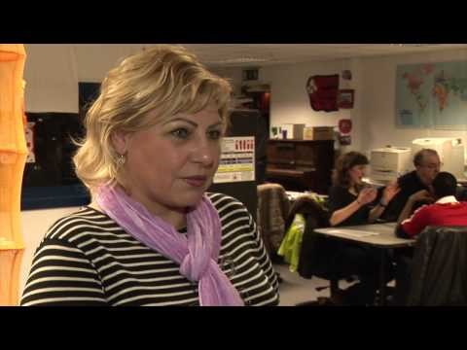
Watch Video: Failte Isteach
Failte Isteach Programme, Ireland – empowering community volunteers to be informal educators
Source: https://www.youtube.com/watch?v=qm3IYXEZcYk

Slide 26
Practice Languages in new ways – International Tandem Night
GOOD PRACTICE
“Tandem is something you do in two, it is a linguistic effort, it is sharing the burden and the honour of teaching and learning a new language. Two people speak first in one language and then in the other.” - Alessandro Piccottini, event creator and organiser
It is an event in Perugia for foreign students and it has become the place to be to meet people from all over the world. Tandem Nights brings together foreign students, but also Italians in search of linguistic and cultural exchange. The average age is 20-24 years but it is also possible meet adults who attend language schools and take the opportunity to practice.
Watch video to find out more: https://www.youtube.com/watch?v=CCZGzCfQ6BQ

Slide 27

Articulate / Heads Up Game – lets adult learners practice a new language
GOOD PRACTICE – FUN CLASSROOM TEACHING ACTIVITY
In these games, the language learners describe words to their teammates against the clock.
It might sound simple, but it’s great fun, and a really effective way to practice a new language and new vocabulary.
You may well have seen the ‘Heads Up!’ app or the related segments on the TV show ‘Ellen’ – check out the clip of Harrison Ford playing the game.

Slide 28
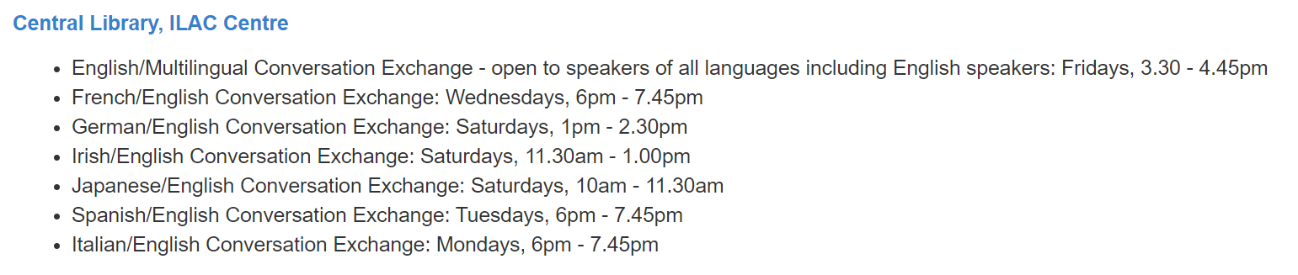
GOOD PRACTICE
Conversation and Language Exchanges
Conversation and language exchanges are an excellent way to practise speaking a language in a more relaxed and social context.
As well as practising your language skills with native speakers through conversation, you can also learn much about the culture, politics and economics of that country.
In Ireland, conversation exchanges are very popular in libraries. Below is as sample conversation exchange schedule from a Dublin City Library.
Source: http://www.dublincity.ie/main-menu-services-recreation-culture-dublin-city-public-libraries-and-archive-events/conversation

Slide 29






Online Language Exchanges
GOOD PRACTICE
There are a host of free online language exchange programmes that refugees and migrants can avail of such as:
Click image to access
The Mixxer Language Exchange
Source: https://www.lifewire.com/free-language-exchange-websites-1357059

Slide 30
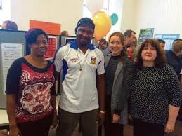
Festival of Languages Celebration - Ireland
GOOD PRACTICE
Festival of Languages was an Anti Racism Week event hosted by Laois and Offaly Education and Training Board. It featured:
displays from many countries
exhibitions from the Travelling Community on their language
Presentation by two Syrians on life in Syria before the war
The whole week was open to the general public to attend and was a great success.
Source: https://www.loetb.ie/contentfiles/OSD/Annual%20Report/Designed%20Annual%20Report%202016%20English%20for%20website.pdf

Slide 31

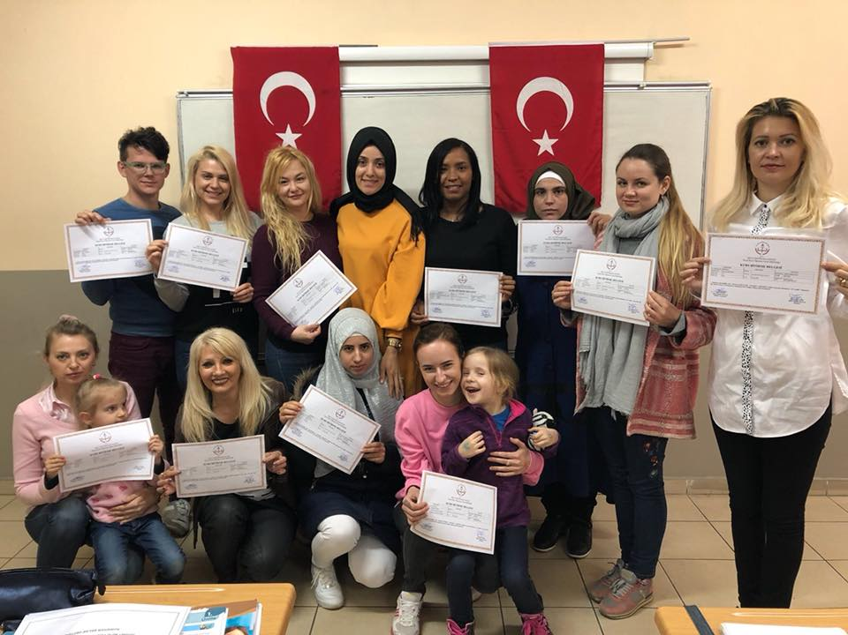
Turkish language course for migrants and refugees in Tuzla, Istanbul - TURKEY
GOOD PRACTICE
The methodology of the language course and is determined by three factors:
an analysis of learners’ communication needs
strong emphasis on language learning through language use
the development of learner’s autonomy
Language courses are held in the locality and results of the training have been very positive in terms of raising the communication of migrant/refugee learners who become more confident in expressing themselves in Turkish language. Increased language skills enables them to be more independent.
Source: http://landofhopeproject.eu/results/

Slide 32

Plain Language / Easy-to-read language
Plain Language makes information accessible and comprehensive for everyone by following certain European wide rules how to make easy-to-read.
Mainly for people with special needs (such as reading and writing difficulties) but also for people for whom the national language is a barrier e.g. refugees.
The Accessibility Act is a law made by the European Union to oblige companies to make their products and services more accessible. Example: election letters should be also made available in Plain Language to include people with impairments and non-native speaker, who struggle to understand the standard language.
Language classes for migrants and refugees could use texts and books written in Plain Language to support learning the language or explain difficult, complex topics.
© European Easy-to-Read Logo: Inclusion Europe.
More information: https://www.inclusion-europe.eu/easy-to-read/

Slide 33
1. LANGUAGE
IN THIS SECTION:
1.3 Collaborating for language teaching success - key insights from providers
We know that not all Service Providers or Educators are in a position to provide language training.
In this case we suggest partnering with specific language training providers in your region/country. In this section, we outline an example of a key language training provider and some insights when designing language programmes for refugees and migrants.

Slide 34

Education and Training Boards, Ireland
Irish ETB’s typically provide twenty hours per week of English Language Learning and intercultural training to all adult refugees as part of a one year resettlement programme.
There are 16 Education and Training Boards across Ireland.
Find an ETB

Slide 35

Some insights from Language Support Workers
An insightful research study was conducted by Dublin City University entitled: An investigation of ESOL provision for adult Syrian refugees in Ireland: Voices of Support Providers
Key learning findings:-
Consider the length of the language training days.
Many refugees and migrants simply did not have the time to devote five hours each day to ESOL (English for Speakers of Other Languages) lessons and find it difficult to maintain concentration for intensive periods of time.
“Think of yourself if you were landed out in the middle of China, would you like to be in class for four hours a day? […] and you’ve still got to worry about getting home and putting on dinners, and shopping and picking up children… the language would be such a small part of your life.”
“I would be suggesting a longer programme and shorter hours.”
Source: http://doras.dcu.ie/23892/1/An%20investigation%20of%20ESOL%20provision%20for%20adult%20Syrian%20refugees%20in%20Ireland%20Voices%20of%20support%20providers.pdf

Slide 36

Some insights from Language Support Workers
Many Language Support Workers wonder about the value of starting the intensive ESOL classes so early in a resettlement programme.
Although all support providers identify English as a key element in a resettlement programme, they acknowledged that the acquisition of English was not always the main priority for the refugees themselves, especially when they first arrived. They were worried about their families back in their home countries or in camps, worried about their health and the health of their families, about how their children were settling into school and crèches, about transport issues and other practical matters. English, while important, was not seen as equally important to these immediate and pressing concern.
Source: http://doras.dcu.ie/23892/1/An%20investigation%20of%20ESOL%20provision%20for%20adult%20Syrian%20refugees%20in%20Ireland%20Voices%20of%20support%20providers.pdf

Slide 37

Some insights from Language Support Workers
“ They’re terrified, they come in to a new community […] and you’re told ‘off you go and be in the class on a Monday’ […] most of them felt that they would like to have settled into the community first […] just to actually let their feet touch the ground […] we felt that on reflection it was not a good idea to have them in classes straight away”
Source: http://doras.dcu.ie/23892/1/An%20investigation%20of%20ESOL%20provision%20for%20adult%20Syrian%20refugees%20in%20Ireland%20Voices%20of%20support%20providers.pdf

Slide 38
Some insights from Language Support Workers
Language Support Workers highlighted that many refugees had not completed formal education or were out of the habit of attending class for long periods each day. In such circumstances, concentration on language learning for five hours each day was felt to be an unrealistic expectation.
Despite being experienced ESOL tutors, all of the ESOL teachers commented on how different this particular teaching context was from any other teaching they had done in their careers and how unprepared they were for this type of teaching. However, there was little to no formal training in the specific context of teaching refugees.
Source: http://doras.dcu.ie/23892/1/An%20investigation%20of%20ESOL%20provision%20for%20adult%20Syrian%20refugees%20in%20Ireland%20Voices%20of%20support%20providers.pdf

Slide 39
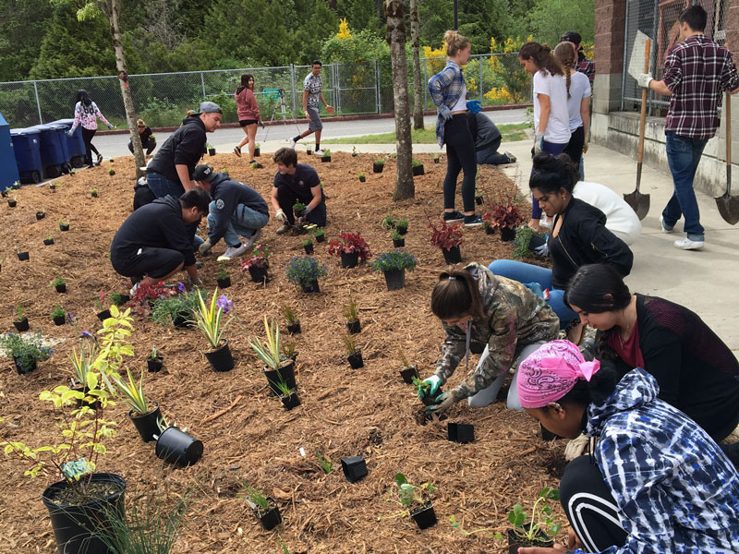
Some insights from Language Support Workers
A mixture of formal and informal learning situations was felt to offer most opportunities for learning. Incorporating the delivery of the formal ESOL classes into extra-curricular activities like gardening classes and cookery demonstrations is favourable.
Consider the value of having mixed nationalities in the classes for at least some of the hours provided.
“One hundred percent improvement in attendance, one hundred per cent improvement in engagement and in their happiness because they were mixed..”
Source: http://doras.dcu.ie/23892/1/An%20investigation%20of%20ESOL%20provision%20for%20adult%20Syrian%20refugees%20in%20Ireland%20Voices%20of%20support%20providers.pdf

Slide 40


The Provincial Centers for Adult Education (CPIA)
It carries out the following activities:
adult education paths aimed at obtaining qualifications and certifications;
initiatives to expand the training offer aimed at integrating and enriching adult education paths and/or fostering the connection with other types of education and training paths. To this end, the CPIAs promote integrated education and training projects, which require collaboration with other public and private training agencies, including through participation in regional, national or Community programs.
research, experimentation and development activities in the field of adult education, aimed - among other things - at enhancing the role of the CPIA as a "service structure".

Slide 41
2. COMMUNICATION
IN THIS SECTION:
2.1 Communicating with people who speak a different language
Effective communication doesn’t happen overnight, it is a number of skills that have to be cultivated and nurtured.
In this section, we look at 5 simple communication skills to help you communicate more effectively with adult refugees and others who speak a different language.

Slide 42

Communication Skills to engage Diverse Multi-lingual Groups
1. SMILE, be personal and make good eye contact!! ☺
It’s a universal language and it helps put everyone at ease. It helps people to feel they are in a safe zone where they can take risks and be vulnerable.
This is very important for working with all minority groups but especially those from refugee backgrounds.

Slide 43

Communication Skills to engage diverse multi-lingual groups
2. Make an effort to pronounce people’s names correctly
Take a genuine interest in the people you are working with/training and try to pronounce their names correctly.
Don’t be embarrassed to make a mistake. If you don’t say it correctly the first time, keep practicing.

Slide 44
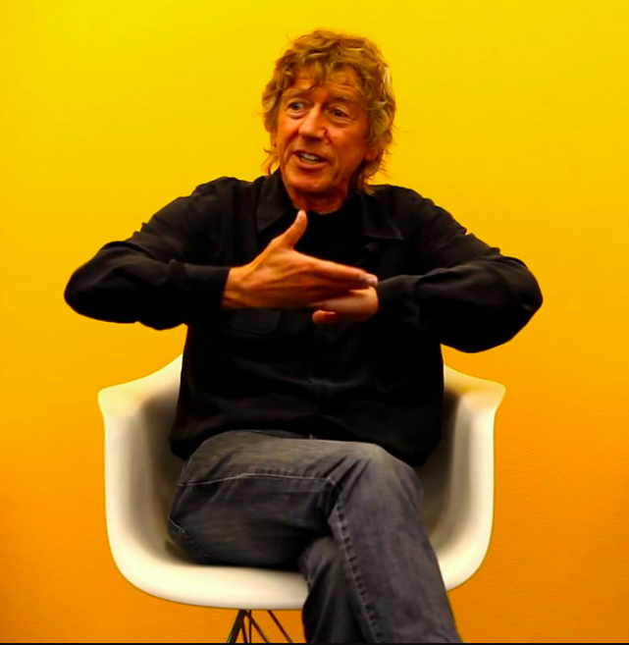
Communication Skills to engage diverse multi-lingual groups
3. Show and Tell
Don’t rely solely on spoken or written language. Where possible:
Use body language that aids in communication
Act it out
Demonstrate using real objects
Use visuals and reinforce with written material whenever possible

Slide 45

Communication Skills to engage diverse multi-lingual groups
4. Speak slower than usual and avoid slang/ colloquialisms
Verbal communication is the term for communication involving words — whether they're spoken, written or signed. Speak slowly clearly and distinctly gives the listener adequate time to process the language and content. Try to:
pause between sentences
use shorter sentences
use simple terminology and avoid the use of slang

Slide 46

Communication Skills to engage diverse multi-lingual groups
5. Listen and be patient
Multi-lingual learners need time to allow them to perform an internal translation process.
For this reason, you will need to be patient, give them time to respond/formulate their thoughts/phrases.

Slide 47
2. COMMUNICATION
IN THIS SECTION:
2.2 Spotlight on
Non-Verbal Communication
Did you know that language-specific words account for only 10% of communication? Or that 90% of the communication process is actually made up of non-verbal information in the forms of tone and body language.
In this section, we look at the difference between verbal and non-verbal communication with a particular focus on no verbal as a key communication skill for those working with refugees, migrants and other multi-lingual groups.

Slide 48

Non Verbal Communication
Language is a very important component of the communication process, but not speaking the same language does not mean that we cannot communicate.
Other factors can be even more powerful than words.
Can you think of some ways we communicate without using words?

Slide 49
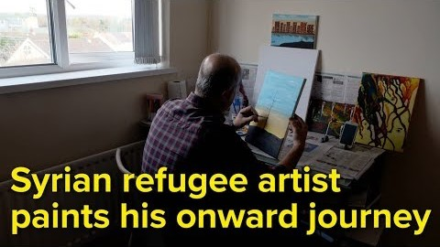
Non Verbal Communication – Communicating through Visuals and Art
Syrian Marwan Mousa was not an artist back at home, but in exile he began sketching and painting, narrating his experience as a refugee.
Without words or English, Marwan illustrates and communicates a journey of pain and hardship, but also discovery of safe harbour in Northern Ireland through his work.
Source: https://www.youtube.com/watch?v=R2gQKxage_0

Slide 50

Non-Verbal Communication
Non-verbal communication includes body language, such as gestures, facial expressions, eye contact and posture. Touch is also non-verbal communication. Think about the impact a firm handshake or warm hug can have vs a loose pat on the back or a timid handshake.
The sound of our voice, including pitch, tone and volume are also forms of non-verbal communication.
Source: https://oureverydaylife.com/the-importance-of-verbal-non-verbal-communication-5162572.html

Slide 51
Types of Non-Verbal Communication at a glance
Body language: our mannerisms and demeanour
facial expressions
gaze—looking at the other person or away from them; paying attention or not
gestures—arm and hand movements
posture—leaning forward or back; relaxed or stiff
distance from the other person—too close or too far
Tone: the way we speak
fast or slow
gently/quietly or loudly/aggressively
pauses

Slide 52






Examine and label these body language cues:

Slide 53
Do you agree with the following?
Authoritive, Angry
Stressed, worried
Happy
Bored, disinterested, unimpressed
Interested, engaged
Disapproving

Slide 54
2. COMMUNICATION
IN THIS SECTION:
2.3 Communicating with Empathy
Empathy is essential to forming and sustaining human relationships but what exactly is empathy and how can it inform your work with adult refugees who may have experienced trauma and migrants?
In this section, we take a look at empathy and how you can develop yours as an agent of inclusion for adult learners through communications.

Slide 55

What is Empathy?
Empathy is the art of seeing the world as someone else sees it.
Empathy has the ability to accurately experience another person’s internal world, emotional pain, and inner conflicts.
Empathy is one of the foundational building blocks of great social interaction and is particularly important with regard to interactions with people who may have suffered trauma like refugees.
Without empathy, there can be no understanding, and without understanding, we don’t ever truly know the people we interact with.
Source: https://www.improveyoursocialskills.com/empathy

Slide 56

How can we develop Empathy?
By being respectful
Developing empathy requires being respectful, sincere, loving and caring.
It requires having an interest in other people’s lives and being open-minded to the differences that make each person unique.
These are all virtues that we can practice and nurture over time.
Source: https://blog.iqmatrix.com/developing-empathy

Slide 57

How can we develop Empathy?
By setting aside Bias
Developing empathy requires us to set aside our own personal biases, opinions, agenda, and beliefs, and choosing instead to accept people wholeheartedly as they are, for who they are.
Empathy doesn’t judge, ridicule, or demean. It’s open and accepting of everyone regardless of their personal beliefs and opinions.
Source: https://blog.iqmatrix.com/developing-empathy

Slide 58

How can we develop Empathy?
By actively listening
Active Listening has a key role to plat in developing empathy. Active listening requires being very attentive and fully concentrating on what is being said rather than just passively hearing the message of the speaker.
Importantly, active listening is also about remembering and understanding the message and then responding appropriately to what is being said.
When you’re listening actively, you are fully focused and paying attention to the other person’s message.
Source: https://blog.iqmatrix.com/developing-empathy

Slide 59
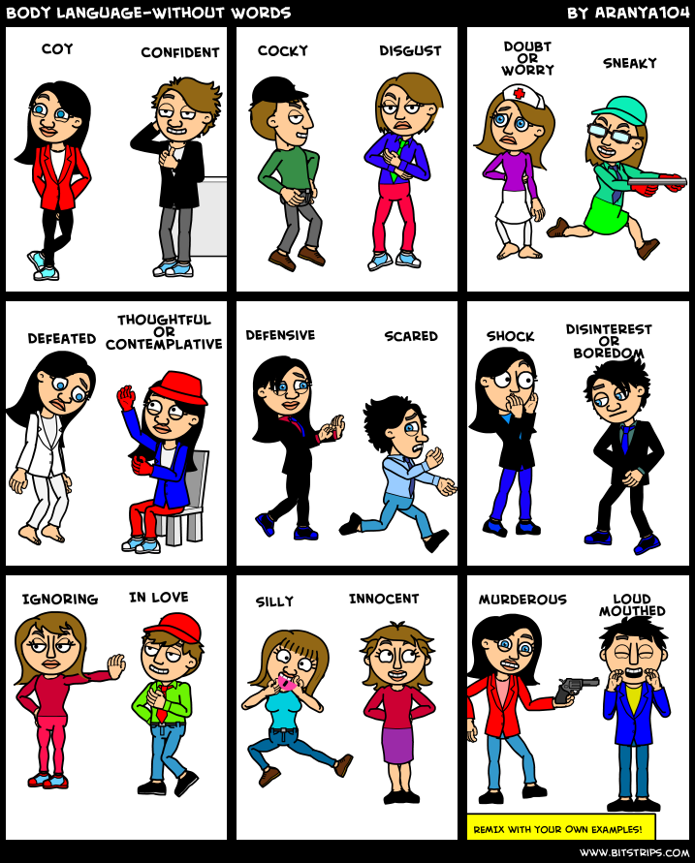
How can we develop Empathy?
By understanding body language
As we explored in non verbal communication, body language is a secret language that can give you a indication of how someone is feeling and how you should act/react.
Pay particular attention as to whether the person uses open body language, or whether they appear to be closed and guarded.
Take notice also of their eye contact. When they communicate, do they look you in the eye, or do they avert their gaze? If they look away while communicating, then it’s possible that they are feeling uncomfortable or trying to mask certain feelings.
Reading body language correctly takes practice so invest some time in it.
Source: https://blog.iqmatrix.com/developing-empathy

Slide 60

How can we develop Empathy?
By asking yourself probing questions
As we shared, empathy is all about trying to put yourself in someone else’s shoes and gain a deeper understanding of their worries and actions.
Some questions to ask:
How does this person feel? Why?
Could they be hiding their true feelings? Why?
What am I hearing the other person say?
What am I seeing the other person do?
Source: https://blog.iqmatrix.com/developing-empathy

Slide 61
2. COMMUNICATION
IN THIS SECTION:
2.4 Technology – a new and innovative means of communication
Technology offers excellent possibilities with regard to multilingual communication.
With the help of an App you can easily hold a conversation with someone speaking a different language.

Slide 62
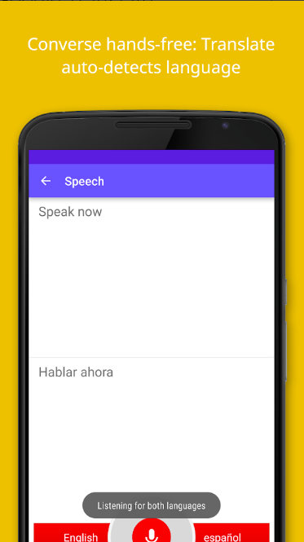
Useful Tool: Google
Translate App
Translate between 103 languages by typing
Conversation Mode: Two-way instant speech translation in 32 languages
Phrasebook: Star and save translations for future reference in any language
Instant camera translation: Use your camera to translate text instantly in 38 languages
Google Translate on Goggle Play Store
Google Translate on App Store

Slide 63
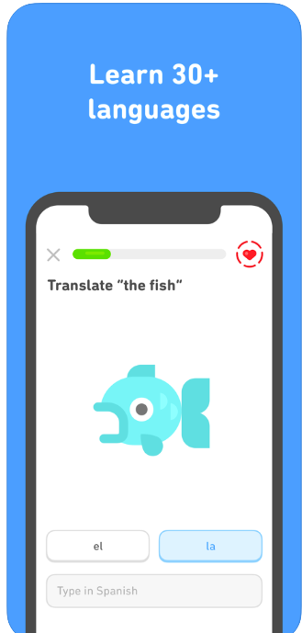
Useful Tool: Duolingo
App
Duolingo uses advanced technology to personalize every lesson for those seeking to learn most European languages
Practice reading, writing, speaking, listening and conversation with intelligent Chatbots.
Track your progress, earn rewards, and join the world’s largest community of language learners.
Duolingo on Goggle Play Store
Duolingo on App Store
English, Spanish, French, German, Italian, Chinese, Japanese, Korean, Portuguese, Russian, Irish, Dutch, Danish, Swedish, Turkish, Norwegian, Polish, Hebrew, Esperanto, Vietnamese, Ukrainian, Welsh, Greek, Hungarian, Romanian, and Swahili.

Slide 64
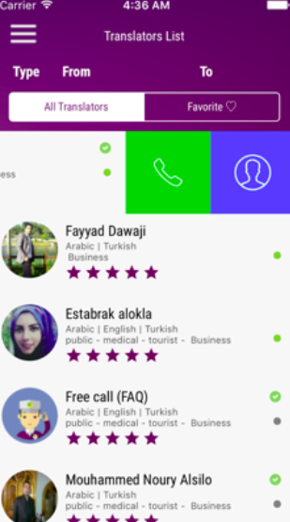
Useful Tool:
Tarjemly-live App
Tarjemly-live is a simple app that connects the user with a translator who is able to provide live, on the spot verbal translation services.
Available in Turkish, Arabic and English, users simply create an account and make an online payment (about $14.99).
The service been used from everything like tracking down a relative in a hospital to handling legal situations in police stations.
Tarjemly-Live on App Store

Slide 65

Useful Tool to learn
Italian : PRESENTE
The app is extremely useful for those who have just arrived in Italy, want to learn the Italian language and more about civilian life to live and integrate in this country. It consists of three parts: a didactic section of exercises on the Italian language, an informative path of texts on civil life in Italy, an agile handbook of phrases and words about body and health.
The app can be used in Italian, but also in English, French, Arabic and Urdu.

Slide 66
Key Communication Takeaways/Exercises
Take the time to think before you speak to ensure that you articulate yourself clearly.
Start studying other people’s body language, facial expressions and intonations, and try to be more conscious of your own physicality and feelings can enhance non-verbal communication.
Listening doesn’t simply mean hearing; it necessitates understanding another person’s point of view.
Pro Tip - Record yourself with both a video camera and an audio recorder to see how you communicate non-verbally. Are your gestures matching your words, or giving away what you’re really thinking?
Source: https://oureverydaylife.com/the-importance-of-verbal-non-verbal-communication-5162572.html

