Slide 1
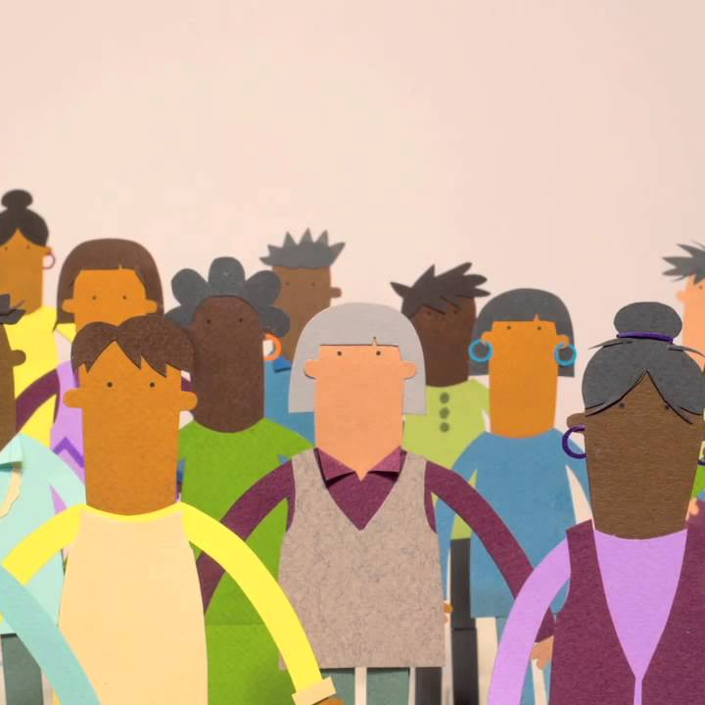
Learning Strand 2
Become an Agent of Inclusion through
Civic Life, Culture and Community

Slide 2
In this lesson, you will learn:
1.1 Spotlight on Social Integration and Inclusion
1.2 Active Citizenship – Educating and Supporting Community Champions
1.3 Best Practices in Orientating New Communities
1.4 Creating Inclusive Communities
2.1 The role of Culture in Integration – focus on key projects and programmes
2.2 Creating Inclusive Community Cultural Spaces
CIVIC LIFE
CULTURE
This project has been funded with support from the European Commission. This publication reflects the views only of the author, and the Commission cannot be held responsible for any use, which may be made of the information contained therein.
Learning Legend:
DOWNLOADS
USEFUL TOOL
GOOD PRACTICE
FUNDING OPPORTUNITY

Slide 3
CIVIC LIFE
IN THIS SECTION:
1.1 Spotlight on Social Integration and Inclusion
Social integration is the process during which newcomers or minorities are incorporated and accepted into society, both as individuals and as groups.
We introduce the four key elements to our social structure that we need to consider.

Slide 4
Service Provider Spotlight
A few years ago, I met a woman at a South Sudanese refugee camp who said something I’ll never forget... Talking about life in the camp, she gestured at rows of temporary homes behind her and said, “Living next to someone doesn’t make you neighbours.”
Her point was simple: close physical proximity to someone else (even someone of the same nationality) doesn’t make a community. Trust, shared stories, common interests...these are the markers of community.
- Shauna Carey, Managing Director IDEO.ORG
Source: https://www.ideo.org/perspective/designing-for-resilience

Slide 5
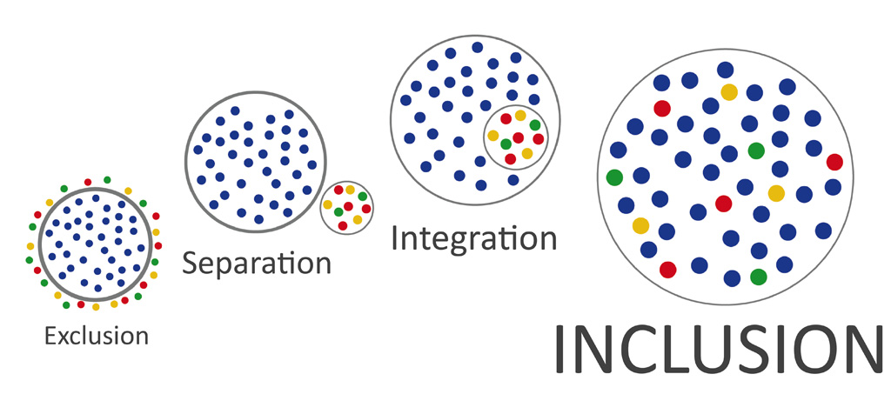
Integration is the crucial first step on the path to Inclusion
Inclusion is the ultimate goal.

Slide 6
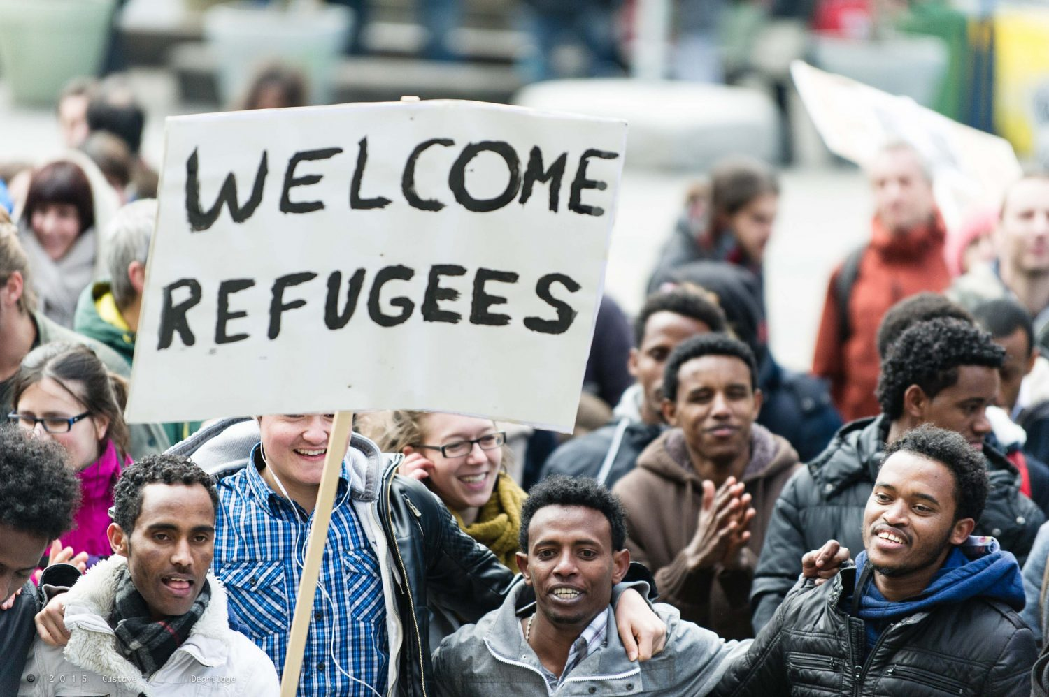
What is Social Integration and Inclusion? And Who is involved in it?
Social integration is the process during which newcomers or minorities are incorporated and accepted into society, both as individuals and as groups. Social Inclusion takes integration one step further and helps newcomers (e.g Refugees) or minorities to become active citizens immersed in society.
Successful integration and inclusion rests not on the actions of one particular group, but rather with many actors— refugees themselves, the host government, institutions (service providers such as yourself) and local communities to name a few.
Source: https://www.migrationpolicy.org/article/integration-role-communities-institutions-and-state/

Slide 7
Four Elements to Social Structure
There are four elements necessary in forming the social structure of society which are interesting to considering with regard to adult refugees entering a new society.
Adaptation: The way we adapt to our environments is one of the ways we function through survival in society. For example, jobs, economy, family.
Goal attainment: The need to set goals and achieve them in society.
Integration: The need to relate to other human beings who share similar interests.
Latency: The need to have people motivate us toward our goals of achievement.
Source: https://study.com/academy/lesson/what-is-social-structure-of-society-definition-theory-quiz.html

Slide 8

Four Elements to Social Structure – Questions…
Adaptation: How can we as educators and service providers help refugees and migrants to adapt to our environments secure jobs, stability and settle their families?
Goal attainment: How can we help them to set goals and achieve them?
Integration: How can we make it easy for refugees and host communities to relate to and understand each other?
Latency: How can we motivate help refugees and migrants towards their goals of achievement?
Source: https://study.com/academy/lesson/what-is-social-structure-of-society-definition-theory-quiz.html

Slide 9
How Integration Works
There are two parties involved in integration processes:
the refugees, with their characteristics, efforts and adaptation
the receiving society, with its interactions with these newcomers and their institutions.
It is the interaction between the two that determines the direction and the ultimate outcome of the integration process.
These two, however, are unequal partners.
The receiving society, in terms of its institutional structure and the way it reacts to newcomers, has much more say in the outcome of the process.
Source: https://www.migrationpolicy.org/article/integration-role-communities-institutions-and-state/

Slide 10
CIVIC LIFE
IN THIS SECTION:
Adults from refugee backgrounds have enormous potential to enhance our society but they often face unique challenges when it comes be active citizenship.
Regardless of nationality or residency status, anyone can be an ‘active citizen’ and with guidance become an Inclusive Community Champion.
In this section, we look at the role of the Service and Education Provider in fostering active citizenship and leadership in the community.
1.2 Active Citizenship – Educating and Supporting Inclusive Community Champions

Slide 11
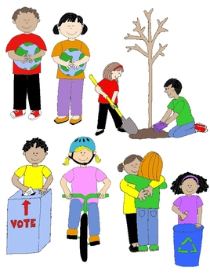
What is Active Citizenship?
Active Citizenship is a term used to describe the involvement of individuals in public life and affairs
Active citizens are people who effect change and become actively involved in the life of their communities; tackling problems and bringing about change.

Slide 12
Active Citizenship – Benefits for Refugees
Refugees can benefit greatly from becoming active citizens in their communities.
By engaging in community groups, refugees and migrants learn more about their host countries, local people and customs.
They can lay the foundations for friendships with natives of the community and empower themselves to be changemakers effecting positive actions in their new found homes.

Slide 13

Active Citizenship can help negate “othering”
“Othering” can stem from
ethnic/racial differences between refugees and their host communities
the Refugee label/status can negatively and their need to reform their identities
treatment by society/host community
Question - Part of the solution to Othering must come from the stories we tell. As the world undergoes profound shifts, how do we build true societies of belonging?
“Regardless of our differences, we are all the same.”
- Marshal B Rosenberg, American Psychologist

Slide 14
Refugee Active Citizenship – Benefits for Communities
The host communities can benefit greatly from the refugees becoming involved as active citizens.
Not only will they get to know and understand the newly arrived group, they will also benefit from the new skills, knowledge and resources that the refugees bring from their own countries.

Slide 15

Inclusive Community Champions – who are they?
A community champion is a changemaker who takes responsibility for the well-being and improvement of their communities. An inclusive community champion is a leader in the community who is passionate about inclusion.
Typically, they mobilize communities for a common cause to design and champion courses of action to overcome specific community challenges. This role could be paid for or voluntarily, most are volunteers.
The Role of the Community Champion work is part education, part inspiration, part motivation and part mobilization.

Slide 16

Why Service Providers need to promote Active Citizenship?
Active citizenship is also about people being empowered to participate in democratic decision-making and effect change in their communities to the betterment of all.
Promoting active citizenship among adult refugees is key the integration process as it gives refugees back a sense autonomy and control of their lives and futures in their host countries.

Slide 17

Why educate and empower refugees and migrants to become active citizens?
Emerging communities need a diversity of leaders. With diverse leadership, our communities will grow stronger.
Migrant and refugee community members have a point of view that the community would like to hear and a set of skills that is unique and valuable.
Diversity of Leadership creates opportunities for respectful dialogue and collective problem solving.
Anyone can learn to be a community leaders. Leadership skills are built step-by-step.

Slide 18
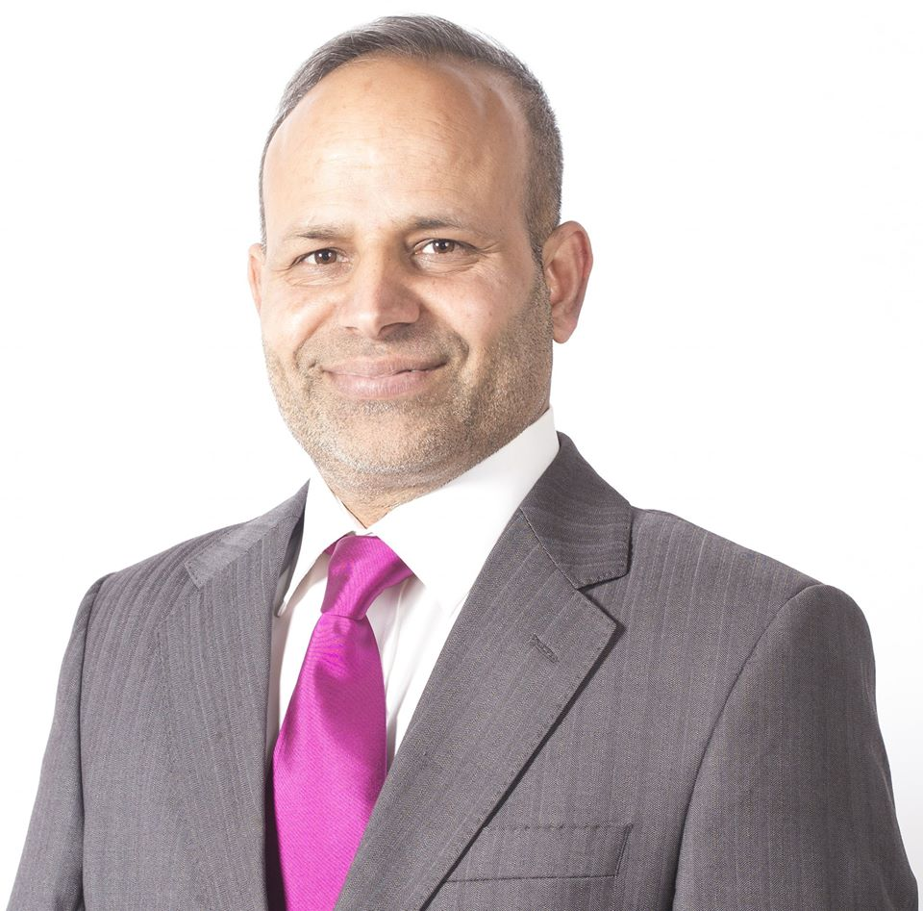
Let’s meet:
Active Citizen and Migrant
Community Champion
Sajjad Hussain (Pakistan Migrant) Ballaghaderreen, Ireland
Sajjad Hussain was born in Pakistan but has lived in Ireland for almost 20 years. He originally came to Ireland on a work permit and has made Roscommon his home.
In 2018, he was one of four people from the Ballaghaderreen to accept a Community People of the Year award in recognition of the town’s response to the arrival of the refugees from Syria.
An active citizen in his community, Sajjad has been involved in the Tidy Towns committee, the youth organisation Foróige and he also founded the local cricket club
In 2019, Hussain contested the local Roscommon election.
More info: https://www.irishtimes.com/news/politics/barber-hopes-to-emerge-a-cut-above-in-roscommon-council-election-1.3797201

Slide 19
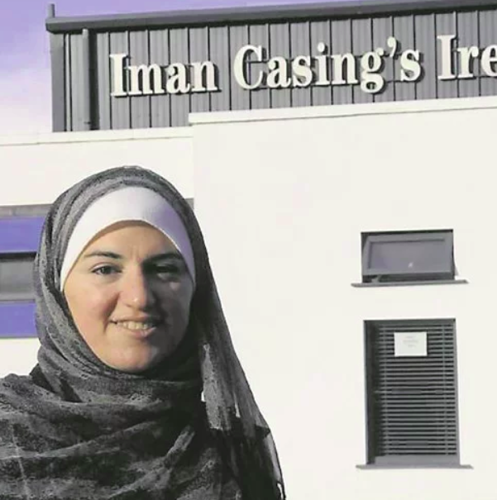
Let’s meet:
Active Citizen and
Migrant Community Champion
Let’s meet:
Manar Cherbatji, Ballyhaunis, Ireland
“I get involved in community groups because of my boys. I have been involved in the Family Resource Centre, the Community Council, the Defibrillator Group, and the Parents Association, in both the national and secondary school.
Myself, I think everybody should get involved because... It’s for their children, it is for themselves, it’s for Ballyhaunis, and it is for Irish people to understand the culture of different nationalities.”

Slide 20


Let’s meet:
Active Citizen and Migrant
Community Champion
Ylenia Pepe: young Neapolitan photographer, a journalist and an aspiring teacher who has lived in Perugia for 5 years
Ylenia has been collaborating with Tamat for two years. The projects in which she was mainly involved were: Umbriamico (project coordinated by Tamat and co-financed by AICS) with the laboratory Biografie In Viaggio and Cultivate Integration. Her active citizen and community champion work includes:
Writing articles concerning migration and integration issues for an online magazine
teaching Italian as a volunteer to foreigners for an association in her neighborhood and teaching Italian to asylum seekers who are involved in the "Let's cultivate integration" project which aims to promote the economic and social inclusion of third-country nationals thanks to the strengthening of their skills.

Slide 21
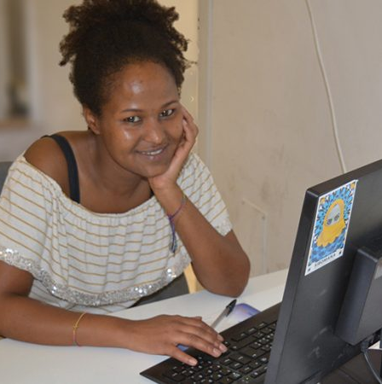
Let’s meet:
Active Citizen and
Migrant Community Champion
Murayo is involved in the
Civil Service in Perugia, Italy
"I chose the Civil Service as it is an experience that objectively changes your life. You see many realities and broaden your point of view. At Sportello Migranti, I learned to see problems from the right perspective and learn what many others have to face and suffer to get to Italy."

Slide 22
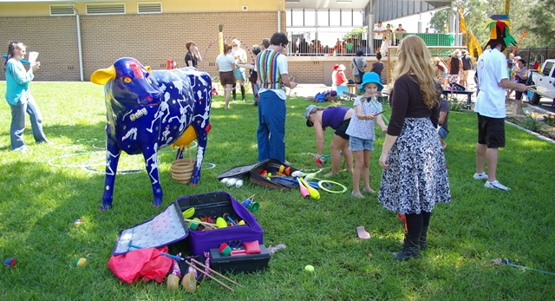
How can Service and Education providers promote and encourage Refugee and Migrants to become Community Champions?
By helping and educating them to:
Have input into plans and projects that benefit the whole community
Bridge the gap between individuals and service providers in the community
Breakdown barriers between conflicting groups
Facilitate community collaboration and active citizenship
Plan events that bring people (refugee, host communities and other ethnic groups) together in a community

Slide 23
How can Service and Education providers promote and encourage Refugee and Migrants to become Community Champions?
By helping and educating them to:
Have input into plans and projects that benefit the whole community
Bridge the gap between individuals and service providers in the community
Breakdown barriers between conflicting groups
Facilitate community collaboration and active citizenship
Plan events that bring people (refugee, host communities and other ethnic groups) together in a community

Slide 24

Communities Integration Fund - Ireland
FUNDING
OPPORTUNITY
The Communities Integration Fund supports a variety of local organisations including sporting organisations, cultural organisations, faith-based groups and volunteer organisations to break down barriers within communities and reach out to isolated members from both Irish and migrant backgrounds, in particular our growing second and third generation of migrants.
Volunteerism is at the heart of these initiatives and plays a key role in its success hence the relevance of this fund to Active Citizenship.
The projects granted funding are small community based projects, with a maximum grant amount of €5,000 and a minimum grant amount of €1,000 allocated to any single project. 282 applications were received this year with 124 projects successfully granted funding.
Source: http://www.integration.ie/en/ISEC/Pages/WP19000006

Slide 25
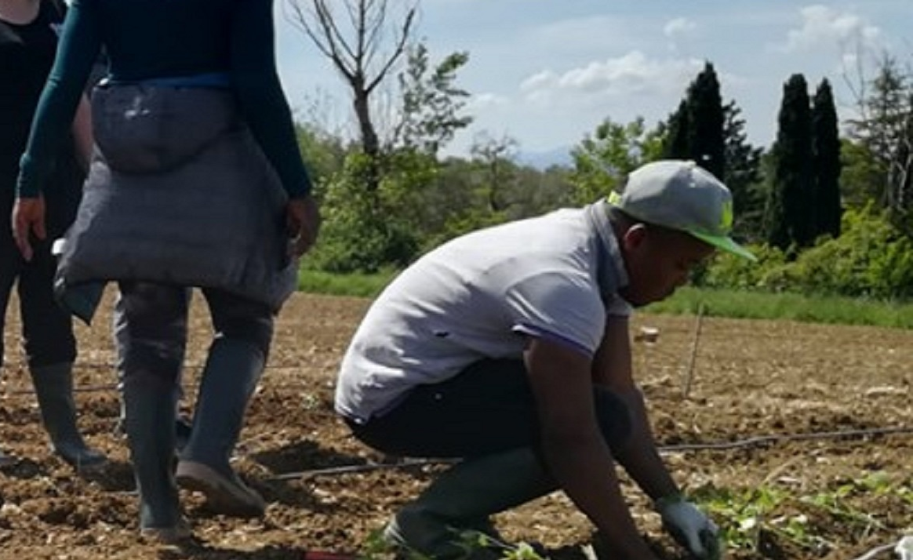
We Cultivate Integration - Italy
Funded by the Migration and Integration Asylum Fund 2014/2020. this project seeks to improve the socio-economic integration of migrants
OBJECTIVES : To encourage the economic and social inclusion of third-country nationals thanks to the strengthening of skills and dialogue between operators and stakeholders, the identification and shared reflection on good practices at European level, and the development of an innovative model to be implemented to strengthen the integration of migrants into host societies through inclusive agriculture workshops.
ACTIVITIES : Creation and sharing of a catalogue of European good practices that use agriculture as a means of inclusion. Development of a sustainable and replicable inclusive agriculture model in different contexts Launch of 3 Inclusive Agriculture Laboratories (Perugia, Milan and Ragusa)
Since this year, production has expanded: tomatoes, ginger, peppers and other typical Italian food have also been grown so that they can be placed on the local market and the project can be sustainable.
Example of Community Integration in Italy

Slide 26

Watch the We Cultivate Integration Video
https://youtu.be/0a5I_4fjPA4

Slide 27
CIVIC LIFE
IN THIS SECTION:
1.3 Best practices in orientating new communities
Orientating refugees in their new host communities is one of the first and most important actions which must take place.
Orientation Guides, Technology and Host Buddy Programmes all have a key part to play. In this section, Service and Education Providers will gain an insight into creating and using these.

Slide 28
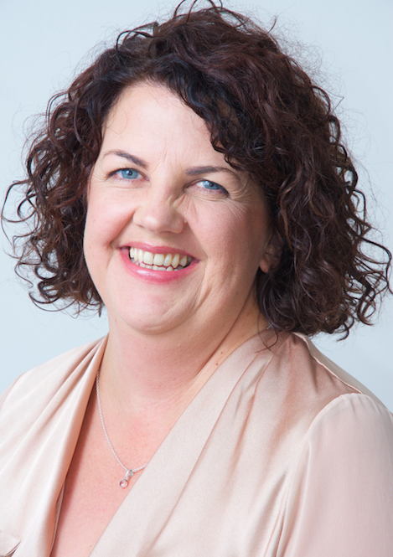
Service Provider Insight
Mairead Horkan, Failte Isteach Programme, Ireland
‘These people (migrants/refugees) are coming from conflict and uncertainty, they’ve seen family members being killed and lost their homes. All they’re looking for is safety while coming to a place they don’t know anything about.
They don’t know if they’re welcome. We need to build that safety and trust for them and you only do that by getting involved, meeting people and by building relationships.”

Slide 29

Create an Orientation Guide
Service Providers include Adult Educators have a key role to play in orientating refugees in their new host countries and the creation of a local Orientation guide is a good first step.
Collaborating with government officials, the local refugee management agency, other stakeholders and members from the host community partners is key to creating a comprehensive guide of value.
Top tips :
Consider partnering with a local writer to make sure the information is conveyed as simply and clearly as possible.
Consult a group of refugees or other persons from different cultures when designing the content to make sure you are approaching the topics in a culturally appropriate tone.

Slide 30
Orientation Guide – key contents
A foreword that explains the purpose of the guide. You may want to explain, that the customs and behaviours described in the guide are how most people act (most of the time!).
Information on:
Social norms and expectations
Community life
Public transportation
National celebrations/holidays
Dining and shopping
Laws protecting personal freedoms
Emergency services

Slide 31
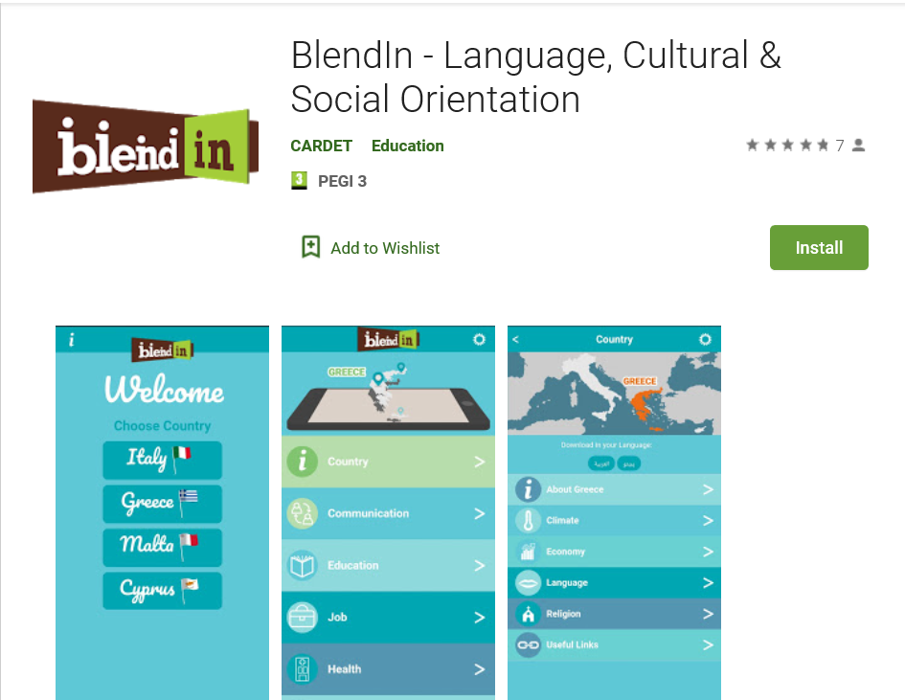
Consider an Online Orientation Guide
Technology is fast becoming a key delivery tool when it comes to refugee and migrant education and training, inclusion in society and as a mean to disseminate entrepreneurship opportunities.
Did you know that Syrian refugees are the thought to be most tech-savvy migrants in history? Or that about 71% of refugee households own a mobile phone?
Blendin Source: https://play.google.com/store/apps/details?id=org.cardet.blendin
Tech Savvy Refugee: https://www.newscientist.com/article/mg23030692-900-are-humanitarian-apps-aimed-at-refugees-meeting-their-needs/#ixzz6BxH6kyNZ , https://unesdoc.unesco.org/ark:/48223/pf0000261278

Slide 32
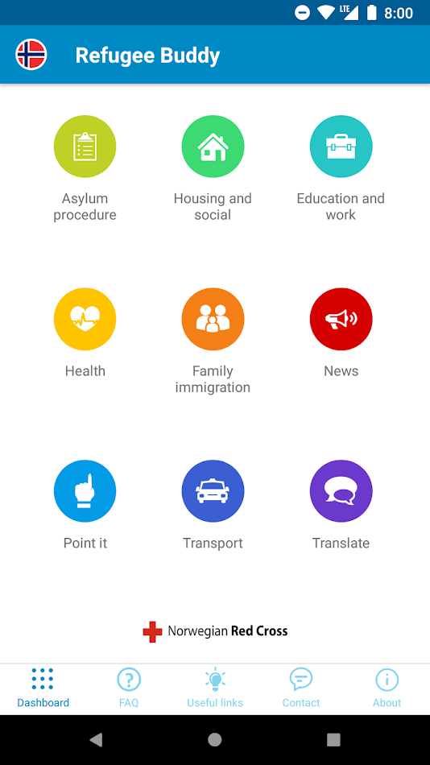
Orientation Apps – Refugee Buddy
This app provides up to date and relevant information to refugees and asylum seekers in countries like Norway, The Netherlands, Canada and Cyprus.
See it on the Google Play Store

Slide 33
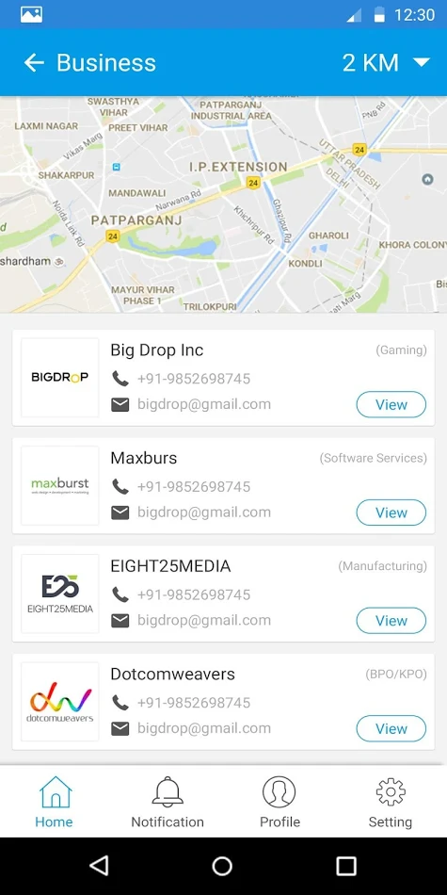
Orientation Apps – RefHope
RefHope adapts itself through geolocation services to provide opportunities that are near and relevant to the individual needs of refugees.
See it on the Google Play Store

Slide 34
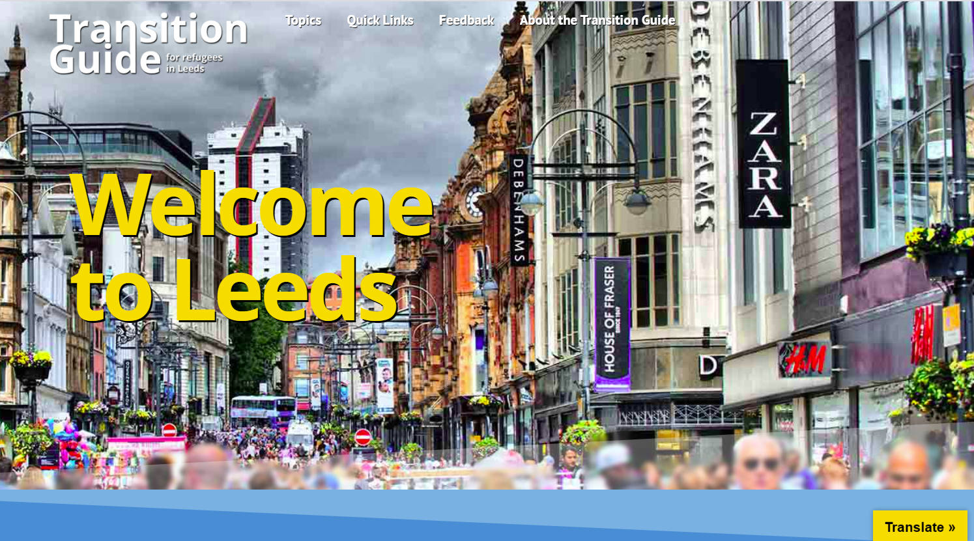
Orientation Website: Transition Guide for Refugees in Leeds
https://transitionguide.org.uk/

Slide 35
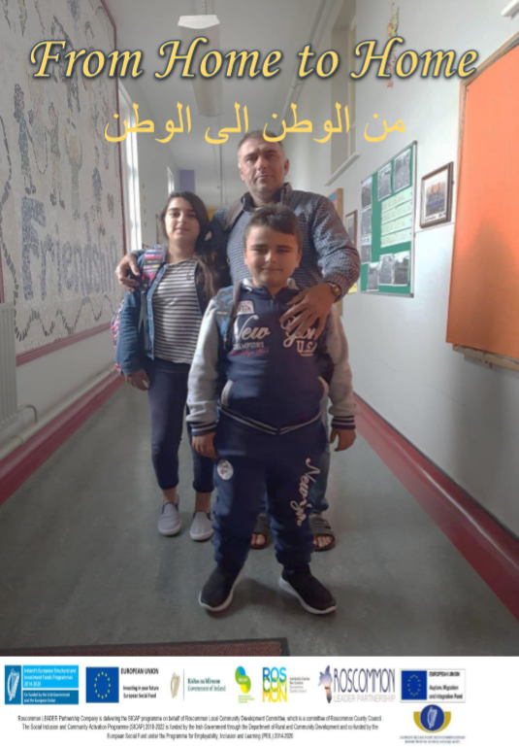
DOWNLOAD
Sample Orientation Workbook for Refugees
The Roscommon From Home to Home Workbook is a practical and useful multilingual tool (English and Arabic) to orientate and integrate refugees.
The main approaches to themes of the booklet (Your New Home, Finances and Banking, Health Services, Travel, Education, Employment, Local Activities, Useful Numbers) are very transferrable and can be adapted easily to suit any other region.
Download the Roscommon From Home to Home Workbook as a learning resource. INSERT ONLINE LINK

Slide 36

Refugee Buddy Programme
A buddy programme is a great way of integrating and orientating refugees. It can be used in a community or educational setting.
For example, in the community, a buddy is someone who befriends and provides practical support to new migrants to navigate and access services, for example accompanying them to an appointment, using public transport or visiting the local park.

Slide 37
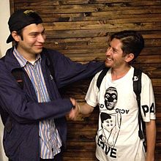

Example of a Refugee Buddy Programme in Action
Leeds Migrant Access Project (see slide XX for more info) runs a very successful buddy programme.
See Leeds Migrant Access Project Buddy Resources:
Buddy Referral Flyer
Buddy Application Form

Slide 38
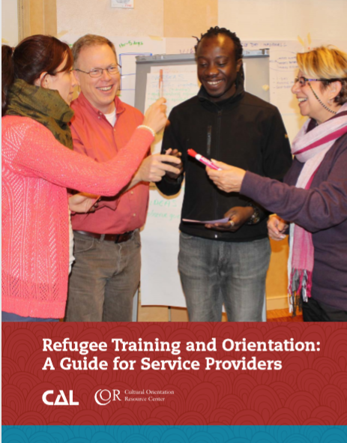
Refugee Training and Orientation - A Guide for Service Providers
USEFUL TOOL
The Refugee Training and Orientation guide includes the following:
Chapter 1: Getting Oriented: Foundations of Refugee Orientation and Training
Chapter 2: Planning a Training Program
Chapter 3: Training Delivery and Assessment: Methods, Materials, Tips, and Tools
Chapter 4: Developing Trainers and Partnerships
Appendix A: Training Strategies (which provides an appendix of the various training strategies offered throughout the guide)
Appendix B: Handouts and Worksheets (to complement information provided in the guide)
Appendix C: Selected Resources (related to topics discussed in the various chapters)
Source: http://www.culturalorientation.net/content/download/4241/23329/version/3/file/Refugee+Training+and+Orientation+-+A+Guide+for+Service+Providers.pdf

Slide 39
CIVIC LIFE
IN THIS SECTION:
1.4 Creating Inclusive Communities
Everyone has a role to play in creating Inclusive Communities.
In this section, we look at some top tips for creating inclusive communities and the vital support role service and education providers have in creating, supporting and promoting inclusive community champions.

Slide 40

What is an Inclusive Community?
One which values diversity and does everything that it can to respect all its citizens, provide full access to resources, and promote equal opportunities.
Works to eliminate all forms of discrimination.
Engages all its citizens in decision-making processes that affect their lives.
Responds quickly to racist and other discriminating incidents.

Slide 41

How can Service Providers and Adult Educators help make the communities they operate in more inclusive?
TOP TIPS
Bring diverse groups of people together in the ordinary spaces that individual community members share in their day-to-day lives:
the playground and recreational areas
community halls/spaces
shopping districts or
schools in the neighbourhood
It’s the interaction that counts.

Slide 42

How can Service Providers and Adult Educators help make the communities they operate in more inclusive?
TOP TIPS
Engage and work with the most influential leaders representing the major groups:
Community councils that comprise of a diverse group of leaders and institutional representatives are best placed to promote the value of diversity.
Working together they can scope out what it would take to help the whole community to embrace and value diversity.

Slide 43

How can Service Providers and Adult Educators help make the communities they operate in more inclusive?
TOP TIPS
Acknowledge and celebrate successful collective action:
Successful collective action not only improves a community, but also strengthens the groups' relationships. It reinforces the positive experience and outcome of working together.
Groups are more likely to want to work together again.
Take time to acknowledge and celebrate even the smallest accomplishment.

Slide 44

How can Service Providers and Adult Educators help make the communities they operate in more inclusive?
TOP TIPS
Create long lasting and sustaining collaborative relationships:
Building an inclusive community is not an event that has a beginning and an end. It is a process that continuously evolves. Nor is an inclusive community something which can be created in isolation.
Forming relationships and creating opportunities to maintain frequent contact and cooperation among different stakeholder, refugee and community groups is key in inclusive community development.

Slide 45
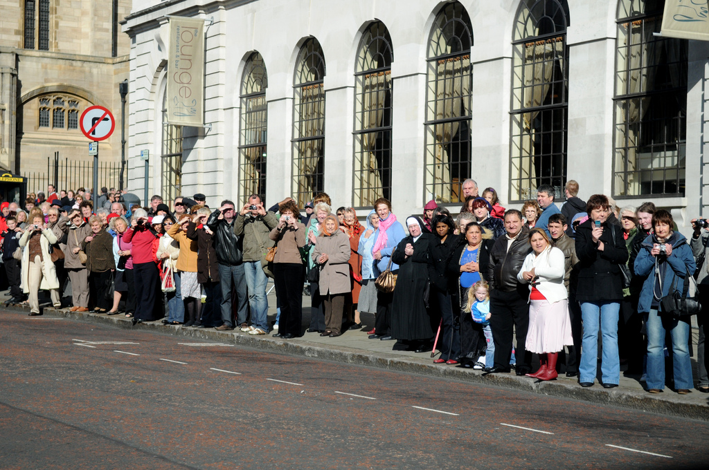
GOOD PRACTICE
Inclusive Community Spotlight:
Leeds a “compassionate city”
Leeds MAP is a collaboration project between Leeds City Council, Touchstone, Feel Good Factor and Leeds Asylum Seekers Support Network to name a few.
The Migrant Access Project builds relationships so newly arrived citizens and service providers can have a conversation, learn from each other and embrace a community-based approach to developing solutions.

Slide 46
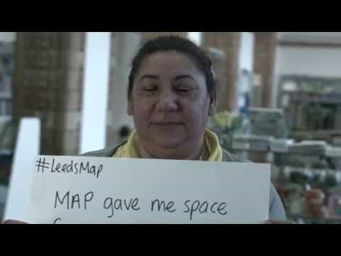
Inclusive Community – Leeds a “compassionate city”
Home to over 140 ethnic groups, Leeds has a rich multicultural heritage, with migrants contributing to the economic, social and cultural life of the city.
This powerful short video from Leeds City Council highlights the valuable work done by the Leeds Migrant Access Project which sends a strong and welcoming message of a community/city willing to accept and support all people.
MAP provides trained people, who speak the community languages, to help and join people with the correct up-to-date information to get the services they need.

Slide 47
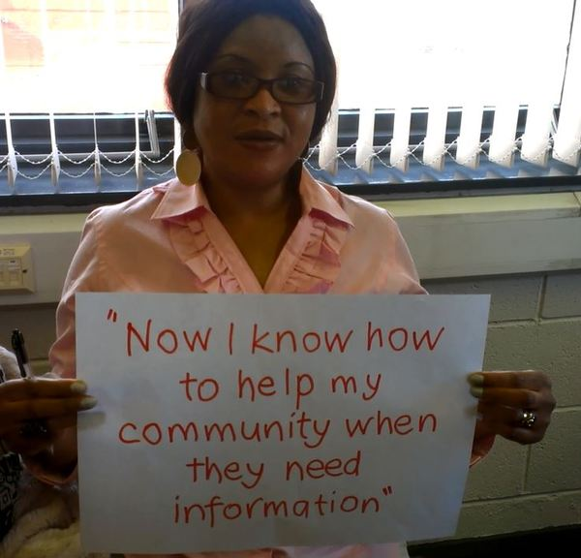
TRAINING ADULT MIGRANTS AND REFUGEES TO BE INCLUSIVE COMMUNTIY CHAMPIONS
GOOD PRACTICE
The Leeds MAP project MAP trains Migrant Community Networkers (MCNs) who are from different national, ethnic or language backgrounds, to talk to new arrivals about life in Leeds.
They are trained with the latest information so they can spread important messages to their communities that help integration and active citizenship.
MCNs then help new arrivals navigate the complex urban system of housing, benefits, employment, health, education and social services.

Slide 48
KEY LEARNING from Leeds MAP
Migrant community leaders are often fellow migrant who have learned skills that others in their community have not yet developed—skills they can share with others such as adjusting to their new country, seeking assistance with immigration concerns, navigating the school system or negotiating with landlords.
Migrant community leaders can play an important role in helping a community respond to anti-immigrant rhetoric and myths
They can communicate the needs of their fellow migrants and obtain the required services from providers such as educational institutions
They can point out how active participation in the political process may provide protection for the community.

Slide 49

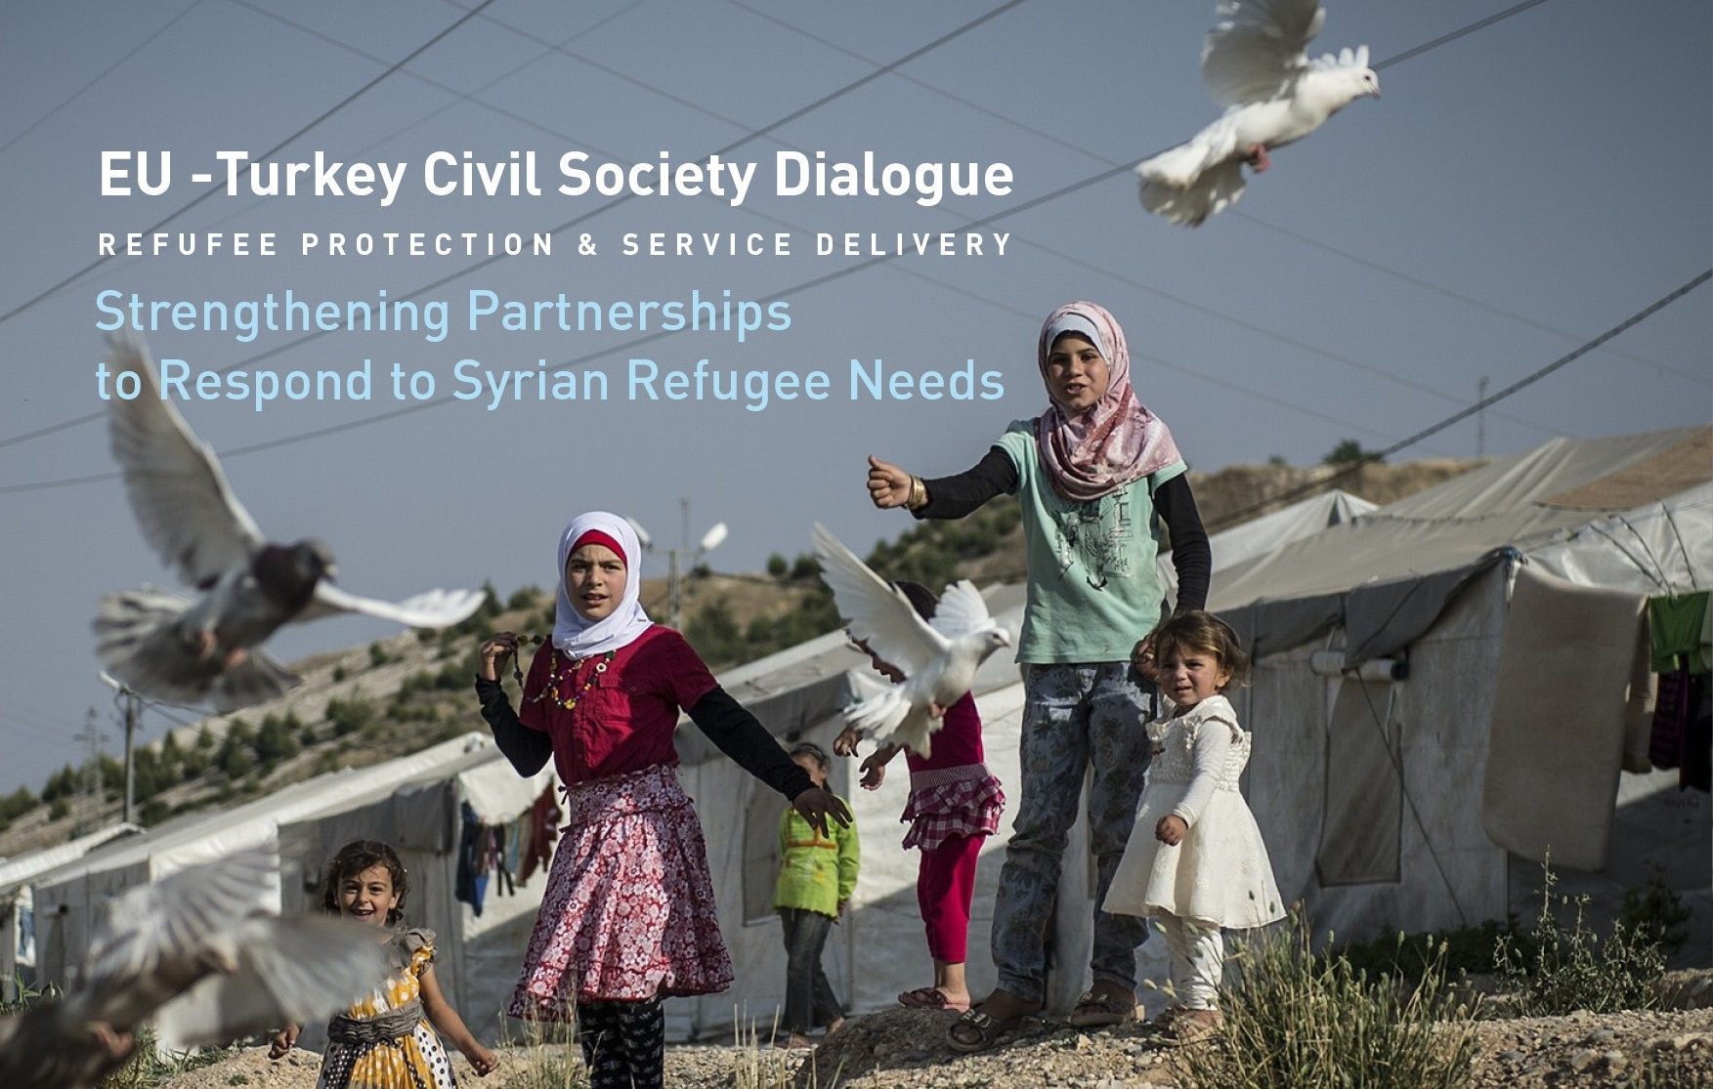
‘EU-Turkey Civil Society Dialogue on Volunteering for Refugee Protection: Strengthening refugee assistance services in Turkey
GOOD PRACTICE
ICMC Europe and project partner Human Resource Development Foundation (HRDF) are partnering in the project entitled Refugee Protection and Service Delivery Dialogue – Strengthening Partnerships to Respond to Syrian Refugee Needs (Refugee Service Delivery Project”.
The project is part of the EU-Turkey Civil Society Dialogue programme, bringing together civil society organisations from Turkey and the EU, to exchange knowledge and experience, and to facilitate an ongoing dialogue between organisations.
Source: https://www.icmc.net/programs/volunteering-for-refugee-protection-strengthening-refugee-assistance-services-in-turkey

Slide 50
2. CULTURE
IN THIS SECTION:
2.1 The Role of Culture in Refugee Integration
Culture is one of best tools to create inclusion in society. It rests on a number of common pillars (music, dance, theatre, food, and art) which transcend geographic boundaries, language and ethnic differences.
In this section, we look at how Integration can be explored through Food, Theatre, Sport and a number of inspiring programmes that Service and Education Providers could potentially replicate in their communities/regions.

Slide 51
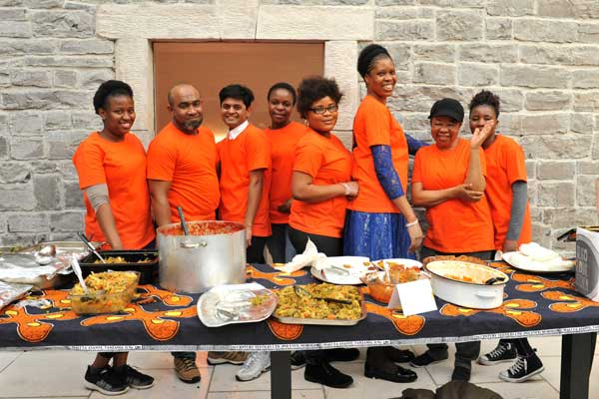
Integration through Food: SLIGO GLOBAL KITCHEN, IRELAND
Project focussed on creating a space where current and previous residents of the Sligo Direct Provision Centre can produce traditional meals, representative of their own countries, and share them with the community.
The project encourages integration by connecting people through the art of food.
Activities to date have successfully allowed locals and members of the migrant community come together during cooking sessions and learn about different cultures in the area.
Read Irish Times Article: Breaking Bread and Barriers in Sligo as global kitchen serves up a taste of the world
Sligo Global Kitchen received from Communities Integration Fund – Ireland, see slide XX

Slide 52
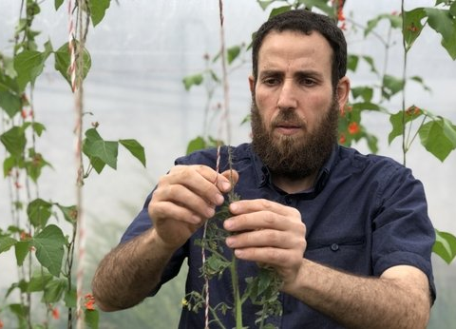

GOOD PRACTICE
Refugee Led Syrian Gardening Project – Carlow, Ireland
Radwan Abouhajar and Mohammad Kadour set up the Syrian Gardening Project earlier this year at the National Learning Network centre in Portlaoise.
The pair took over two unused polytunnels at the back of the centre and began planting seeds (cucumber, beans, peas, radish, tomatoes, salad leaves, parsley, garlic, onions and spinach) that had come from their war-torn homeland.
“There are many avenues in our
local communities to welcome
different nationalities”
SERVICE PROVIDER SPOTLIGHT: National Learning Network provides a range of flexible training programmes and support services for people who need specialist support in 50 centres around Ireland. Learn more about NLN: https://www.rehab.ie/national-learning-network/

Slide 53
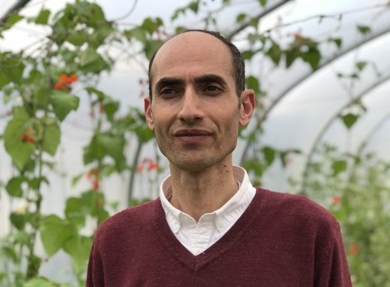
Syrian Gardening Project – Carlow, Ireland – Refugee Perspective
“This project makes me feel I can produce, I can give and I can contribute. People here offered us help with so many things, like learning English and accommodation. So I feel it's up to us to give something back and contribute positively to society.”
Radwan Abouhajar (pictured) was a Farmer in Syria holds a holds a BSC in Ag Science, now works for Offaly Local Development Company, is working to establish similar polytunnel projects with the Syrian communities in neighbouring towns.
More info: https://www.rte.ie/news/ireland/2019/0619/1056369-syrian-vegetables/

Slide 54
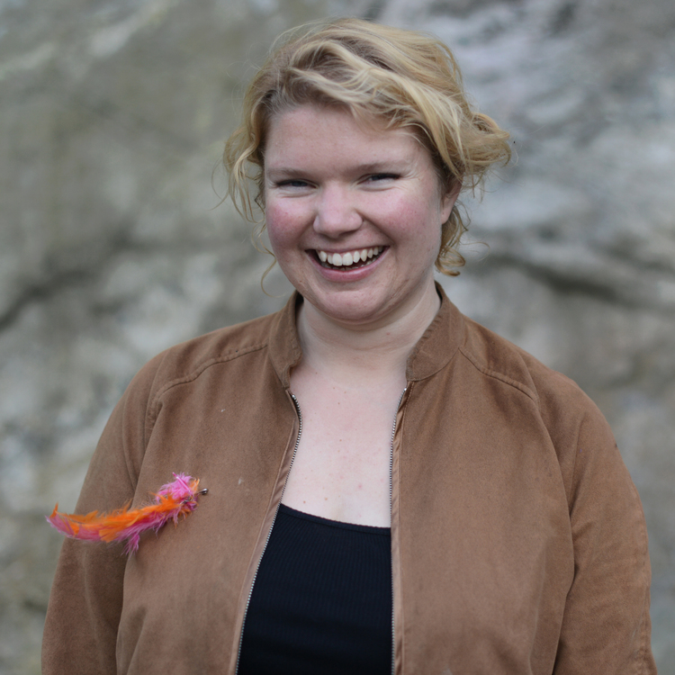
Integration through Food: UNITED INVIATIONS, SWEDEN
Language teacher, Community Champion and Minister of Dinners, Ebba Akerman ran into one of her students on the train and asked him whether he enjoyed living in her country.
She found the answer deeply disturbing.
It became clear to her that most of her students, living in neighbourhoods packed with immigrants, had virtually no contact with native Swedes.
So she decided to do something about it. Thus United Invitations was born which the idea of to connecting locals and newcomers over homecooked dinners.
Let’s meet: Ebba Akerman

Slide 55
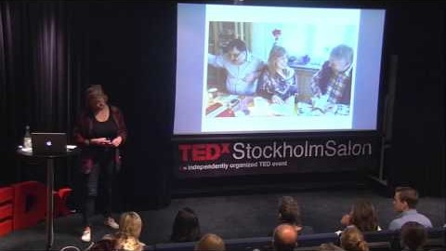
Integration through Food: UNITED INVIATIONS, SWEDEN
Watch Ebba in her TEDx Talk as she explains the whole concept.

Slide 56
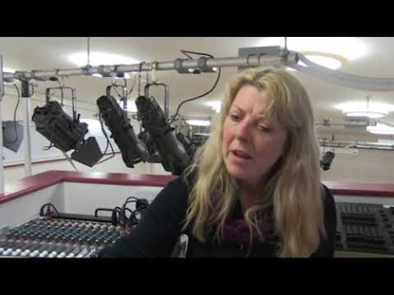
Integration through Community Theatre: REACT PROJECT
Community Theatre provides a vehicle by which individuals from refugee communities are given the opportunity to explore their life experiences through a process of discussion, role-play, improvisation and developed theatre skills.
Acting and Theatre can have a very positive impact on participating individuals; developing language and communication skills, presentation skills, self-confidence and self-awareness.
The REACT project (2016-2018) originated the concept of Refugee Engagement and Integration through Community Theatre.
Read more about the REACT project
A snapshot of the REACT project in Bristol.

Slide 57
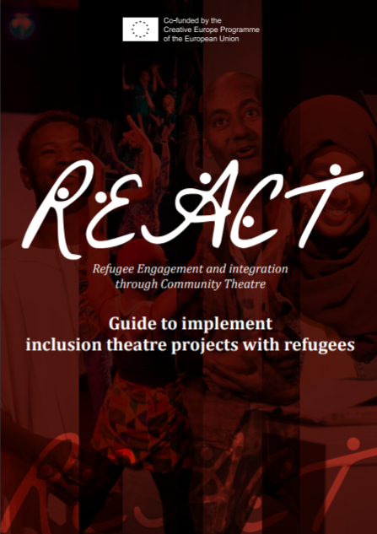
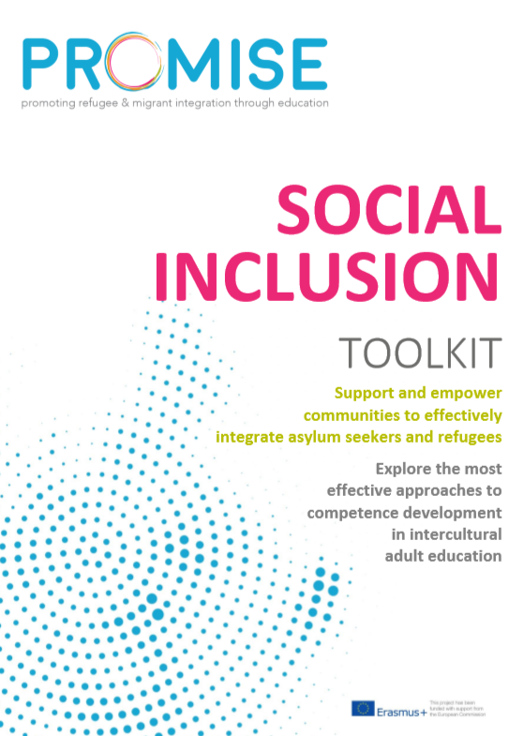
Integration through Community Theatre: REACT PROJECT
The REACT project has published a very useful resource: Guide to implement inclusion theatre projects with refugees.
The aim of this guide is to share the learning of the three partners, and present this information in an accessible format, so that it may be easily read by other organisations interested in using community theatre as a tool for integration between refugee and host communities.
The guide is furnished throughout with suggestions and recommendations for all those organizations / agencies / theatres which may wish to implement a similar project in their own context
Download the REACT Guide
For more good practices,
check out our 56 page
Promise Social Inclusion
Toolkit
DOWNLOAD

Slide 58
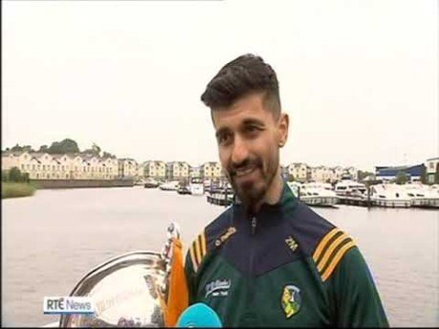
Integration through Sport: Zac Moradi, Leitrim Ireland
In the 1980’s, Zac Moradi’s family fled to in Iraq to escape the Iran-Iraq war. Then second Gulf War, forced them to uproot again and this time they ended up in the very different surroundings of Carrick-On-Shannon, Leitrim.
At 11 years of age, Moradi developed a passion for gaelic games and in 2016, Moradi was on the Leitrim team that won the Lory Meagher Cup a day he describes as
“one of the proudest days of his life."

Slide 59
Integration through Sport: GAA and Sport in Ballyhaunis,Ireland
Ballyhaunis GAA has been at the forefront of helping immigrants and asylum seekers to bed down in their new home. An integration day during the summer was a huge success and in a town like Ballyhaunis with much less social amenities than larger towns or cities, the role the club plays has been magnified.
Pakistani names have featured on Ballyhaunis hurling teams for over two decades. There are eastern European and Syrian names on the Ballyhaunis soccer team while the recently established Ballyhaunis Cricket Club is a strong outlet for members of the Muslim community.
Source: https://www.irishexaminer.com/lifestyle/features/life-in-ballyhaunis-irelands-most-culturally-diverse-town-369099.html

Slide 60

Documentary GAA and Integration in Ballyhaunis

Slide 61
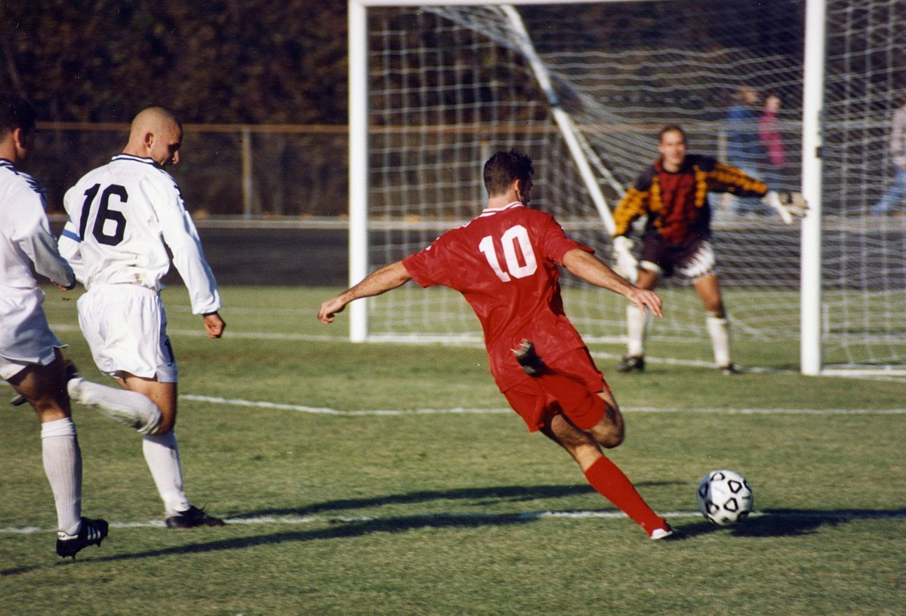
Integration through Sport: Amnesty International Football Welcomes Campaign
Football Welcomes is a way for the footballing community to celebrate the contribution of refugees to football and appreciate what it means to flee conflict and persecution.
Football Welcomes is part of Amnesty International’s I Welcome campaign for a better international response to the global refugee crisis.
The campaign encourages local communities to work together to create a more welcoming environment for people fleeing conflict and persecution
Source: https://www.amnesty.org.uk/press-releases/football-players-and-celebrity-fans-back-amnestys-football-welcomes-weekend

Slide 62
2. CULTURE
IN THIS SECTION:
2.2 Creating Inclusive Community Cultural Spaces for Leisure and Learning
Creating an inclusive future for all requires us to examine our public spaces (streets, parks, neighbourhoods), public services (housing, transportation) and public institutions (schools, libraries) and ensure that they serve the entire population.
In this section, we focus on how service providers and educators can work towards the creation of inclusive community spaces for all.

Slide 63
Creating Inclusive Community Spaces
A key purpose of a community space is to create room for all members of the community to take part in civic, physical, and social activity.
To create an inclusive community space, we need to think about how we can extend that function to as many members of the community as possible.
There are many steps – big and small – that can be taken to create community spaces for inclusion.
Leadership can come from many stakeholders. This includes municipal officials, local residents, newcomer communities, local business, labour and media.
To get some ideas, let’s examine some inclusive community spaces and see how these projects came about…

Slide 64
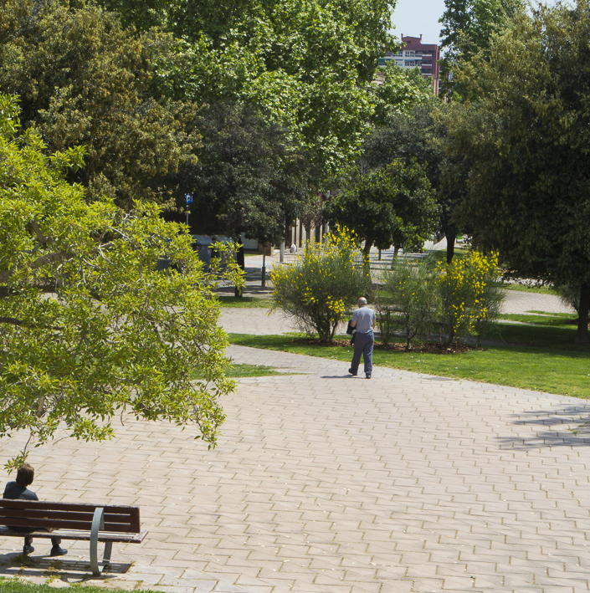
Parc Central de Nou Barris
City of Barcelona
Parc Central de Nou Barris is an award-winning park that creates a green community space for one the city’s more diverse neighbourhoods.
In the Barris district, there are people from Spain, Romania, Ukraine, Ecuador, Pakistan and the Philippines.
In 2007, the Parc Central de Nou Barris won the International Urban Landscape Award and was commended for playing an important “integrative task in a rapidly expanding and multi-ethnic quarter of Barcelona.
Click to read full case study on the Parc Central de Nou Barris

Slide 65

Cultural Interest Centres, Mardid’s Open Library Project
Public libraries have tremendous potential to be inclusive spaces and foster a sense of connection and belonging for all.
In Madrid, the Open Library Project (Biblioteca Abierta) initially focused on language barriers by offering new multilingual collections and services such as Spanish language lessons and computer literacy courses.
Phase two saw the creation of Cultural Interest Centres in the library where both immigrants and the local population come together for cultural activities such as discussions, art exhibitions, storytelling, reading workshops and more.
A key part of the Open Library Project included the recruitment of bilingual intercultural mediators.
Click to read full case study on Cultural Interest Centres in Madrid’s Libraries

Slide 66
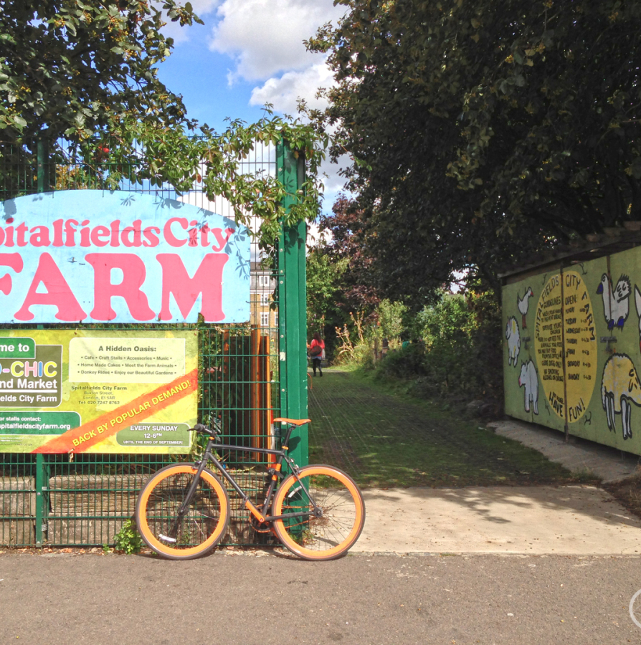
Spitalfields City Farm, East London
Spitalfields City Farm is a community space that is open 6 days a week and is free for everyone. he farm was started in 1978 in response to local people’s demand for allotments. 40 years later, the farm has become an inclusive community space with clear objective to match:
To give people the opportunity to become members of their community and encourage participation in the development of the farm
To provide children and young people with a safe, stimulating and inclusive space in which to play and to connect with nature.
Click to read more about Spitalfields City Farm

Slide 67
Key Communication Takeaways/Action Points
Have another think about your answers to questions surrounding the four social structure elements. What can you implement now or in the future?
Think about your community. Who are the local community champions? What can you/your organisation do to encourage more refugees and migrants to become community champions?
Is your community/the one you are working with inclusive? Is there room for improvement? What supports/education programmes or approaches might help make it more inclusive?
Inclusive community spaces have a key role to play in social cohesion and intercultural understanding. Are your community/public spaces open and accessible to all including refugees? Now could be a good time to conduct an audit.
Source: https://oureverydaylife.com/the-importance-of-verbal-non-verbal-communication-5162572.html

