Slide 1
Learning Strand 3
Become an Agent of Inclusion through
Education and Enterprise

Slide 2
In this lesson, you will learn:
EDUCATION OF ADULT REFUGEES AND MIGRANTS
1.1 Role of Adult Education in promoting Diversity and Inclusion
1.2 Understanding the training needs of Adult Refugees and Migrants
1.3 Innovative Adult Teaching Methods for Refugees and Migrants
2.1 Employment as a mean to Integration and Inclusion
2.2 Spotlight on Refugee and Migrant Entrepreneurship
2.3 Useful resources to support and promote Refugee/Migrant Enterprise and Employment
ENTERPRISE AND EMPLOYMENT
Learning Legend:
This project has been funded with support from the European Commission. This publication reflects the views only of the author, and the Commission cannot be held responsible for any use, which may be made of the information contained therein.
DOWNLOADS
USEFUL TOOL
GOOD PRACTICE
FUNDING OPPORTUNITY

Slide 3
EDUCATION
In this section:
1.1 Role of Adult Education in promoting Diversity and Inclusion
Education is a fundamental human right and essential for the exercise of all other human rights. It plays an important role in promoting social cohesion, and an appreciation of diversity as a value.
In this section, we look at how education can promote refugee and migrant individual freedom and empowerment and yield important development benefits which contribute to the development of people and society.

Slide 4
What Role does Adult Education play in Inclusion?
Adult education provides an opportunity to promote the values of tolerance and solidarity. It is about bringing people together from different cultures, so they meet, interact, share opinions, and discuss their differences, and thus they can realise they have the same objectives, and they often tackle similar challenges.
Tania Berman, European Association for the Education of Adults
Source: https://epale.ec.europa.eu/en/blog/what-role-does-adult-education-play-refugee-crisis

Slide 5
What Role does Adult Education play in Inclusion?
Adult education can introduce the migrant/refugee community to the host population. Courses and informal educational activities that deal with the move towards a more diverse society can reduce tensions between communities, and also eliminate inefficiencies in the labour market
John Field, a professor of Lifelong Learning at the University of Stirling
Source: https://epale.ec.europa.eu/en/blog/what-role-does-adult-education-play-refugee-crisis

Slide 6
Adult Education as an Integration Tool
In terms of integration and inclusion, education can help refugees and migrants to build resilience, self-efficacy and social skills. While also helping host communities to learn about new cultures and the principle of diversity.
Adult Education helps all individuals to make informed and competent decisions. It helps to provide information, improve cognitive skills and strengthen peoples socio-emotional capabilities.
Adult education plays a critical role in building the human capital of refugees and migrants who may lack a high school diploma or equivalent and cannot enter other forms of education
Education can offer an ideal environment for refugee and migrant learners to develop healthy habits and participatory attitudes.
Education is key to more democratic and fair societies..

Slide 7
Adult Education as an Integration Tool
Adult Education can help advance refugee and migrant language learning and employment opportunities
Adult education also has the potential to serve as an on-ramp to employment and the opportunity for refugees and migrants to start earning a family-sustaining wage.
Language learning (as we learned in PROMISE Strand 1) represents a key integration challenge, with language attainment being very necessary for effective functioning in the community and the workforce.
Source: https://www.migrationpolicy.org/topics/adult-education-language-learning

Slide 8
Education as an Integration Tool in a Community Setting
Education cannot play its integration role in isolation. Great things can happen when education providers engage with community leaders and provide a platform for education-based integration efforts for migrants.
For example, Adult Education providers can focus some of their efforts on encouraging migrants and refugees to become more active citizens in local communities and give them sufficient opportunities to engage in civic activities.

Slide 9
“Education is one of the many ways of preserving the human dignity of refugees, and clear guidelines are needed so these groups of people do not end up being socially and educationally disadvantaged”
Refugee Information Service director Josephine Ahern
https://www.irishtimes.com/news/immigrants-face-education-barriers-1.789686

Slide 10
EDUCATION
In this section:
1.2 Understanding the Training Needs of Adult Refugees
Individual training needs of refugees and migrants can vary depending on the person's reason for coming to the EU.
Their expected length of stay as well as their skills, level of education and working experiences also influence their training needs.
In this section, we examine the typical training needs of refugees and migrants and get a sense of the types of education supports they might require.

Slide 11
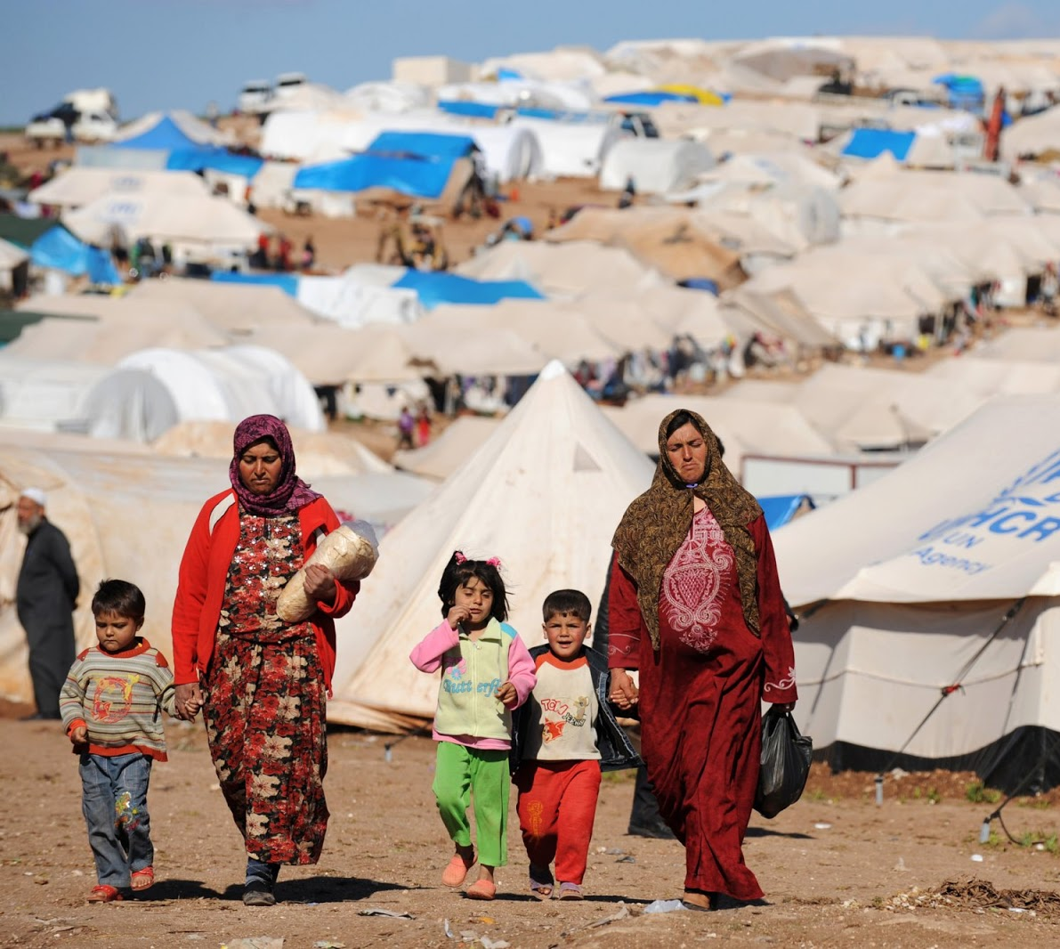
Training Needs of Refugees
Refugees are people who have been forced to leave their country in order to escape war or persecution. This group face very specific complex problems which adult education may be able to address, such as:
vulnerability resulting from traumas suffered
lack of documentation including education documentation
cultural and language barriers
risks of stigmatisation in education and on the labour and the housing market

Slide 12
Training Needs of Migrants
Migrants are people who make a conscious choice to leave their country to seek a better life elsewhere.
Migrants training needs differ quite significantly from those of refugees. Some migrants for example, are highly-skilled third-country nationals who move for economic purposes and require little adult education/integration support other than language lessons.

Slide 13
Snapshot of migrant education in Europe
First and second-generation migrant students have a much higher rate of low-achievement than natives
Figures are particularly striking for first-generation migrants, for whom the low achievement rate exceeds 30% in maths, science and reading in most countries across the EU, while for native the rates are usually below 15%.
Only in countries with a long tradition of attracting highly educated migrants, such as the UK and Luxembourg, there are first-generation migrant students who perform better in mathematics than their top-performing native counterparts.
The same broadly holds for Ireland, which is a newer destination for highly educated migrants.
Source: https://ec.europa.eu/jrc/en/news/integrating-migrants-education-and-vocational-training-key-address-disadvantages

Slide 14
Topics Adult Education can cover to meet some needs of Refugees and Migrants
LIFE SKILLS – self awareness, empathy, decision making, problem solving, stress management
SOCIAL SKILLS – active listening, relationship management/building, respecting and understanding others
COMMUNICATION SKILLS – language learning, interpersonal skills
COLLABORATION SKILLS – working with others, team building, leadership skills
CIVIC SKILLS – active citizenship, community engagement, volunteering,
ADULT LITERACY - reading, writing, maths, IT skills
EMPLOYABILITY SKILLS – CV writing, interview preparation, information on the labour market in host countries, entrepreneurship
OTHER RELEVANT SKILLS – orientation

Slide 15
EDUCATION
In this section:
1.3 Innovative Teaching Methods for Adult Refugees and Migrants
Diverse training groups require different didactic and pedagogic approaches to support the learning of all students and this is particularly relevant in teaching and engaging refugee and migrant adult learners.
In this section, we introduce some of the most innovative teaching methods for delivering training to adult refugees and migrants.

Slide 16
How do Adults like to learn?
Adults like to learn based on experience. They need to feel actively involved in their training, which, in turn, needs to be relevant and solve actual problems.
To engage adults (including refugees and migrants), adult education training needs include innovation and interactive instruction that is based on real-life situations and learning in practice.

Slide 17
Methods/mechanisms of training that work well for Adults Refugees and Migrants
There are a range of teaching methods which work well with refugees and migrants. Lets look at:
active learning
peer instruction/learning
learning through games/play
storytelling
intergroup empathy
differenced instruction

Slide 18
What is ACTIVE LEARNING?
Active learning is any approach to instruction in which all students are asked to engage in the learning process. Active learning stands in contrast to "traditional" modes of instruction in which students are passive recipients of knowledge from an expert.
Active learning can take many forms and be executed in any discipline. Commonly, students will engage in small or large activities centered around writing, talking, problem solving, or reflecting.
Why is Active Learning important for Adult Refugees and Migrants? It can give them back a sense of autonomy – something refugees in particular may feel like they have lost.
Source: https://cei.umn.edu/active-learning

Slide 19
GOOD PRACTICE
ACTIVE LEARNING EXAMPLE – Creative English
Creative English is an applied theatre programme for adults in the UK that balances creativity and learning in a functional way. needs while developing confidence in English language communication skills.
Drawing on participant-led, practice-based research Creative English, combines playful emotional engagement with pragmatic subject matter.
Through improvisation, Creative English reduces inhibitions and creates a fun active environment conducive to language learning.
Source: http://research.ucc.ie/scenario/2016/01/Smith/01/en

Slide 20
GOOD PRACTICE
ACTIVE LEARNING EXAMPLE – Creative English
Creative English - what motivated the training participants?
Illiteracy – some were illiterate in their first language, other had passed an English certificate but lacked confidence to practice and speak English
Informal training – some like the idea of it being an alternative to a formal ESOL course
Others simply hoped to be able to attend a doctor’s appointment on their own, or to speak English with their grandchildren, who were the second generation born in the UK
Why teach through Art/Theatre? Refugees and migrants need an opportunity to break out of patterns of behaviour associated with struggling to survive. Theatre and the arts, can offer a creative release.
Source: http://research.ucc.ie/scenario/2016/01/Smith/01/en

Slide 21
GOOD PRACTICE
Active Learning – Involving Refugees in the Teaching Process
“We want to open up networks to non-Danish citizens. Not just by inviting refugees in to be learners but also to contribute as instructors, teachers etc.” - Trine Bendix Knudsen
DAEA’s goal is to promote intercultural dialogue, foster tolerance and ensure the integration of immigrant communities in their host societies.
Danish Adult Education Association (DAEA) is an umbrella organisation representing 34 adult education organisations working with non-formal or in-formal in Denmark.

Slide 22
GOOD PRACTICE
Mairéad O’Riordan, freelance adult education tutor, Dublin and Dun Laoghaire (DDLETB)
Innovative Adult Educator Spotlight
Mairéad O’Riordan is a freelance adult education tutor affiliated to DDLETB. She has been working as an adult education tutor for more than a decade. She practices innovative teaching styles and favours:
active learning strategies - she breaks the learners into groups and has one group working on maths at a board and another group working out a problem on the computer
peer learning/teaching she believes benefits everyone involved
“It is vital to get learners involved in their own learning, to build their confidence and foster a sense of control and empowerment.”
Source: https://www.nala.ie/wp-content/uploads/2019/08/Meeting-the-challenge-strategies-for-motivating-learners-in-adult-education-in-Ireland.pdf

Slide 23
GOOD PRACTICE
Digital Literacy Course for migrants and refugees in Tuzla
Improving basic digital skills of refugees
Tuzla Public Training Centre in Istanbul periodically organises Digital literacy course for migrants and refugees on the basis of designed module* for refugees and migrants in Tuzla district, Istanbul - Turkey.
These courses are organised in order to improve refugees’ basic digital skills and digital literacy and to promote the socio-economic integration and inclusion of the refugees, migrants and asylum seekers into the host society.
Tuzla has recognised that before full integration of migrants and refugees into the adult education system is possible, some degree of separate training to help bring the group up to the same speed/level of native learners.
Source: http://landofhopeproject.eu/results/

Slide 24
Peer Learning/Teaching
Peer Learning/Teaching is a method by which one learner instructs another learner in material on which the first is an expert and the second is a novice.
We have learned that adult refugees and migrants need/want to be involved in the learning/education process, and peer learning/teaching is a great method/mechanism. It gives the refugees/migrants a sense of ownership over the training content/material, allows them to share their expertise and to help comprehension particularly where varying low host language levels are concerned.
Peer Learning/Teaching has lots of benefits for Adult Refugees and Migrants particularly when the peers are from host communities.

Slide 25
Refugee/Migrant Insight
Top Tip - Involve Refugees in the Teaching Process
“I came to Sweden to meet my husband that already was in Sweden. Now I have my family here my husband and 3 children. I am studying Swedish at Swedish for Migrants (SFI). It’s very difficult to learn the Swedish language. When I am not learning the language, I like to do some cooking. My dream is to work as a teacher here in Sweden.”
Mayyada Mousa is a 45 year old,
Iraqi woman, living in Sweden
Refugees and Migrants want to have an active role in the Education Systems in their new countries.

Slide 26
GOOD PRACTICE
Watch Video: Failte Isteach, Ireland
Our Failte Isteach Good Practice from PROMISE Learning Strand 1 is a great example of peer instruction/learning in practice.
Failte Isteach Programme is a English conversation programme which empowers Irish community volunteers to become informal peer educators to refugees and migrants
Source: https://www.youtube.com/watch?v=qm3IYXEZcYk

Slide 27
GOOD PRACTICE
Roseanne Dunne, Limerick City Adult Education Centre
Innovative Adult Educator Spotlight
Roseanne Dunne works as an English tutor to Speakers of Other Languages (ESOL). Her learners are all non-Irish nationals and their primary need is English language acquisition.
Roseanne uses interactive strategies of teaching like peer learning and the language experience approach to get people from different countries working together. This approach introduces general interest topics (like sport or shopping) and works on the vocabulary that emerges from the learners’ paired work on these topics
The language experience approach (LEA) promotes reading and writing through the use of personal experiences and oral language.
Source: https://www.nala.ie/wp-content/uploads/2019/08/Meeting-the-challenge-strategies-for-motivating-learners-in-adult-education-in-Ireland.pdf

Slide 28
Learning though Games/Play
There is no denying that games make learning fun and making learning fun motivates people, helping them to pay attention and stay focused on the training topic.
Games are also a great ice-breaker and inclusion tool to get groups mixing, talking and working together. Let’s take a look at how they can be used in Adult Education for Refugees and Migrants.
“Laughter is the shortest distance between two people.” - Victor Borge

Slide 29
Learning though Games/Play – an Italian example
This book proposes a vast and original collection of educational games as a tool to develop learning skills in the student. The purely linguistic activities are set in a real philosophy of the game as a recreational, motivational, energetic, multisensory activity. Therefore, in addition to the more classic activities of oral and written comprehension and production, there are also many games to encourage concentration, improve group dynamics, break the ice, open and close a lesson or course, form groups or couples, separate different moments of the lesson, create relaxation or recharge.
Introduction: https://www.almaedizioni.it/media/upload/anteprime/FRO_intro_fonti.pdf
An example: https://www.almaedizioni.it/media/upload/anteprime/3.1.13_fisico_bestiale.pdf
The motto is "learn without noticing you're learning" and without effort, stimulating creativity and the courage to experiment.

Slide 30
Innovative Adult Educator Spotlight
Refugee/Migrant Insight
A game in motion at ActionAid Denmark
Five people are busy unpacking some dry spaghetti. The spaghetti is quickly assembled into bundles, which are taped together. A young women discusses with two men how best to tie the bundles together. At the same time, there are two older men enthusiastically gesturing to the young people. They are not allowed to say anything. The group has to construct a bridge together; a spaghetti bridge.
The game often breaks into laughter, and the atmosphere is one of energy and fun.
At the asylum centre in Avnstrup, games like this play an important role. They force exercise people to work together without speaking, they break tension and create a fun, learning environment.
Source: https://epale.ec.europa.eu/sites/default/files/get_inspired_-_12_danish.pdf

Slide 31
Innovative Adult Educator Spotlight
Refugee/Migrant Insight
ActionAid Denmark uses games to bridge communication gaps
“Play puts people in a situation where they are more open to each other, learning and telling some of those stories they aren’t used to sharing with others. So games can serve as a sort of can opener.” - Christel Winther, ActionAid Denmark
Shemi a young woman from Damascu explains that the playful games work well: “The playful nature of the exercises gives us an opportunity to get to know each other in a different way. The exercises allow you to sense in another way whether a person is happy or sad.
Source: https://epale.ec.europa.eu/sites/default/files/get_inspired_-_12_danish.pdf

Slide 32
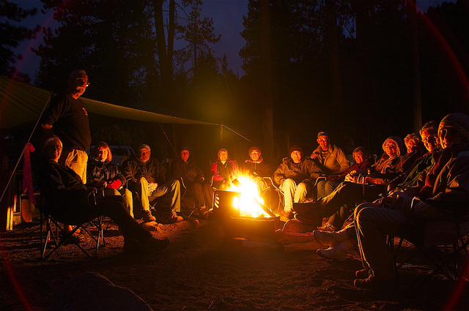
Storytelling as an Adult Teaching Tool
Storytelling is one of the most powerful methods of communication. In education, stories can humanize experience and lead to deeper learning/understanding.
Storytelling offers us the opportunity to connect to like-minded characters, or see the world literally from within someone else’s skin.
Storytelling is particularly effective in teaching adults as it affords them the chance to make the learning relatable by bringing in past experiences.
Stories touch our emotions and make us laugh, cry, and get angry—a sharp contrast to a basic presentation!
Source: https://buffer.com/resources/science-of-storytelling-why-telling-a-story-is-the-most-powerful-way-to-activate-our-brains

Slide 33
Innovative Adult Educator Spotlight
Ethnic Women Stories through Craft – a training initiative of Creative Spark, Ireland
Refugee/Migrant Insight
Ethnic Women Stories through Craft brought together 8 women from different nationalities to learn about ceramic making and each other’s cultures through the sharing of food and stories.
Craft and Food offered the opportunities for storytelling and engaging multicultural learners in a shared interest inclusion project.
Creative Spark is an education provider/community development organisation in Ireland with champsions inclusion and the promotion of diversity as a rich community development tool.
Source: https://www.youtube.com/watch?v=oj5WJUyBoMU&feature=youtu.be

Slide 34
Intergroup Empathy – a key Teaching Mechanism for Inclusion
Empathy is a crucial skill for everyone to have. It is a process that allows one person to know, feel, and understand the internal states of another person, and respond accordingly.
In the adult education, the introduction of role playing can help participants to think in different ways and to look at issues from a new angle.
The benefits of empathy in education include building positive learning environment, strengthening community, and preparing students to be leaders in their own communities.
Facilitating education and awareness around Intergroup Empathy is crucial when trying to bring diverse communities together and promote inclusion.

Slide 35
Differentiated Instruction and Learner Centric Teaching Methods
Differentiated Instruction involves providing different levels or instructional techniques for different individual students. It is a very important process in Adult Education for refugees and migrants where very different skills (language, literacy etc.) may be present.
As an adult teaching method, differentiation involves modifying and adapting materials, content, learning projects learning needs of students.
Learn more about Differenced Instruction
Facilitating education and awareness around Intergroup Empathy is crucial when trying to bring diverse communities together and promote inclusion.
Source: http://teachingrefugees.com/instructional-programming/

Slide 36
ENTERPRISE
In this section:
2.1 Employment as a mean to Integration and Inclusion
For most refugees, when asked what makes them feel integrated, the first thing they think of is to have a job. But the employment of refugees not only benefits them, it also represents significant economic potential for receiving countries, hosting communities and local businesses.
In this section, we take a brief look at Employment as a mean to Integration and Inclusion, who is involved and what barriers need to be overcome.
Source: https://www.oecd.org/els/mig/UNHCR-OECD-Engaging-with-employers-in-the-hiring-of-refugees.pdf

Slide 37
Who is involved in supporting in refugee and migrant employment?
The successful labour market integration of refugees can only be achieved through joint efforts of all relevant actors:
Governments (create an appropriate legal employment framework)
Public employment services and local government (co-ordinate the governing structures at national, regional and municipal levels)
Recruitment agencies
Employers and their associations (Trade unions etc.)
Relevant civil society organisations – education providers etc.
Refugees themselves
Host communities

Slide 38
Why employment for Inclusion?
Employment provides refugees with crucial economic independence and purpose which is necessary for inclusion into wider society
Although other elements (such as language learning or cultural ‘integration’) are often discussed as pillars of integration, employment is both a means to these goals and an end in itself

Slide 39
Barriers to refugee and migrant inclusion in the labour market
In most countries, there is no national strategy to aid the transition of refugees into the labour market.
However labour market supports are provided by service/education providers, NGOs and community-based charities who provide specific and tailored refugee employment services.
Regarding the causes for lack of entry into labour market inclusion, some common barriers can be seen. These are outlined in the next few pages..

Slide 40
Barriers to refugee and migrant inclusion in the labour market
Language Barriers
Lack of host language skills is one of the most significant obstacles to obtaining employment.
Those with poor language skills are likely to have access to a much smaller range of employment and training opportunities.
Language features strongly in our PROMISE Approach to Inclusion – see strand 1 for more about the need for effective language programmes for adult refugees and migrants
Source: https://breaking-barriers.co.uk/the-cause/refugee-employment-crisis/

Slide 41
Barriers to refugee and migrant inclusion in the labour market
Gaps on CV
Significant gaps on the CV due to sometimes prolonged asylum processes during which most refugees are unable to work pose a barrier for employment when refugees finally do secure work permits.
Adult service/educators can fill this void by offering relevant training and/or creating opportunities for the refugees to volunteer or gain work experience.

Slide 42
Barriers to refugee and migrant inclusion in the labour market
Lack of relevant work experience, appropriate training or unrecognised educational and professional qualifications.
Lack of work experience in host country which is often prerequisite for getting a job. Also some refugees have qualifications that they cannot prove because they are unable to obtain duplicates of the necessary paperwork.
This can be an issue for economic migrants too as their qualifications may not transfer to the receiving country.
Short work placements and other job experience opportunities are important but also training to help the newcomers to acclimatise to a different language and a different culture of work.

Slide 43
Barriers to refugee and migrant inclusion in the labour market
Lack of references
Being a newcomer in a new country means that refugees and migrants often lack access to networks (character references, previous employer references etc.) which would strengthen employment prospects and knowledge of recruitment methods.
Refugees may have no, or limited, social and professional connections in the receiving country which make things very difficult for them.
Service/education providers in direct contact with refugees and migrants are one of a few who know these people the best. Consider your own position? Could you to be a character reference? Refugees/Migrants who become active in their communities should be encouraged to seek references locally and be encouraged to build up their name and stature.

Slide 44
Barriers to refugee and migrant inclusion in the labour market
Social Stigmas
Racism and negative stereotyping is probably the most inhibiting of all the barriers that refugees and migrants face with regard to entry into the labour market.
Cross-cultural misunderstandings can contribute to misplaced suspicion and hostility.
For employers, there mat be perceptions that additional costs and admin will be required when hiring a refugee.
Service/educator providers have a key role to play here and can become the missing link needed to bring refugees and prospective employers together. In the next few pages, we suggest some resources which may be useful in this work.

Slide 45
Integration and Inclusion through Employment - Success Stories
Skills 2 Work Project Erasmus+ project has captures individual accounts from refugees and employers in 9 European countries regarding the labour market integration of refugees.
Follow the link - Case Studies from Belgium, Italy, Slovenia, Hungary, the Netherlands, Spain, Ireland, Slovakia and the UK,

Slide 46
ENTERPRISE
In this section:
2.2 Spotlight on Refugee and Migrant Entrepreneurship in Europe
Entrepreneurship is an effective approach to overcoming some of the challenges of economic access and social inclusion challenges faced by refugees and migrants.
It can offer adult refugees and migrants financial autonomy, opportunities for community engagement and tremendous personal growth.
In this section, you will be inspired by the stories of many refugees/migrants who have set up thriving businesses. As a result, you may consider including entrepreneurship in your refugee/migrant service delivery.

Slide 47
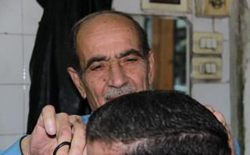
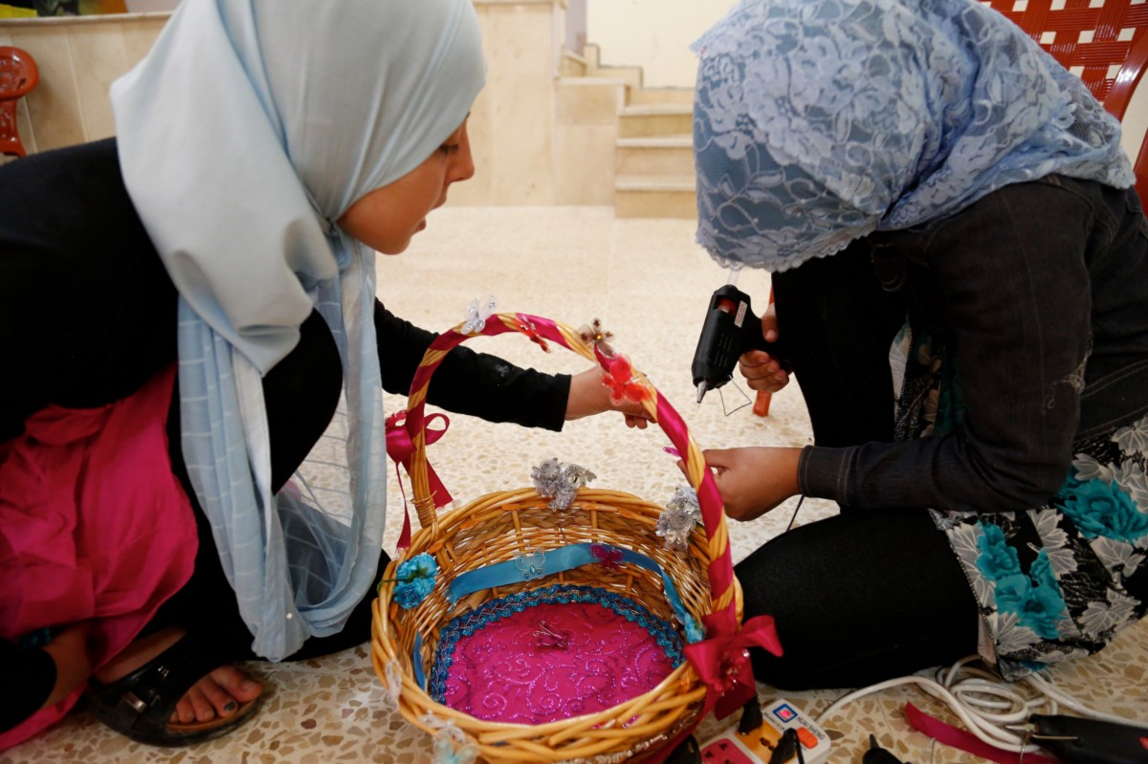
Entrepreneurship as an Inclusion Tool
Entrepreneurship can be an effective way to include migrants and refugees in local economies, by sharing their knowledge and entrepreneurial spirit, and creating new market opportunities and cross-border networks.

Slide 48
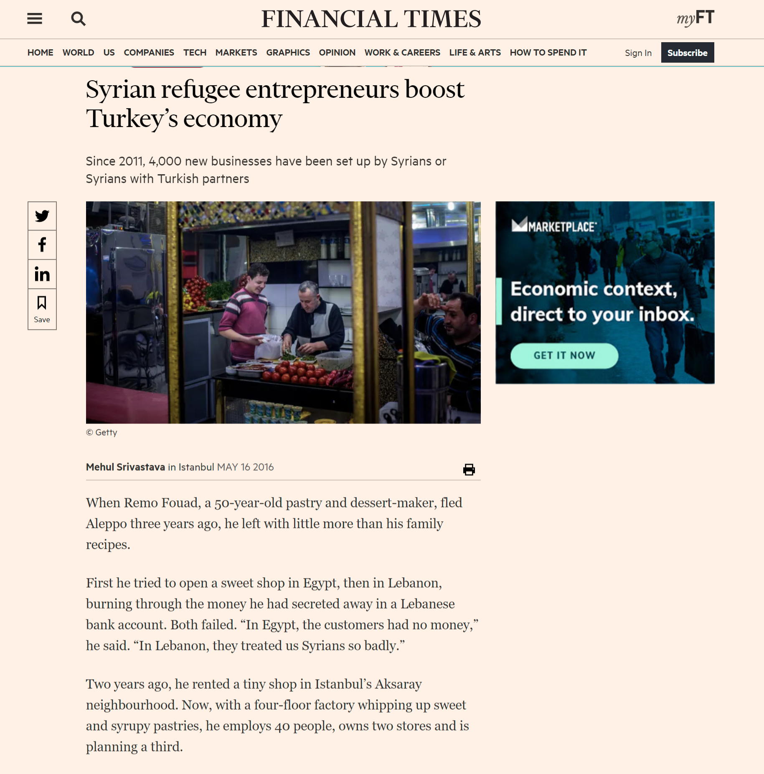
Syrian refugee entrepreneurs boost Turkey’s economy
Since 2011, 4,000 new businesses have been set up by Syrians or Syrians with Turkish partners
When Remo Fouad, a 50-year-old pastry and dessert-maker, fled Aleppo three years ago, he left with little more than his family recipes. In 2014, he rented a tiny shop in Istanbul’s Aksaray neighbourhood.
Since then Remy has opened a four-floor factory whipping up sweet and syrupy pastries, opened a number of stores and employs over 40 people.
Read full Financial Times article
Spotlight on Refugee and Migrant Entrepreneurship in Turkey

Slide 49
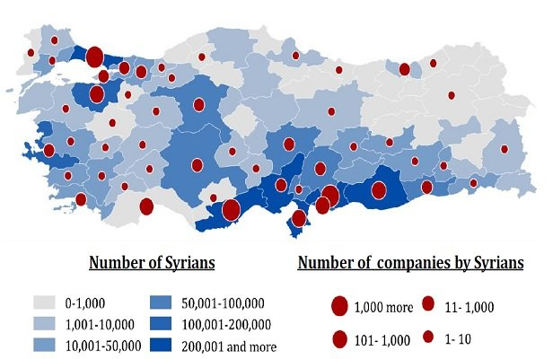
Syrian Entrepreneurship and Refugee Start-ups in Turkey: Leveraging the Turkish Experience
A recent study of the Economic Policy Research Foundation of Turkey shows that Syrian entrepreneurs provide a living for 7 percent of the 3.5 million Syrians in Turkey. Over the course of eight years, Syrians in Turkey established more than 10,000 companies where an average of 7 people are employed and of whom 60 percent are Syrians. In relation, the average Syrian household size consists of 6 people. Hence, findings, although not with certainty, indicate that approximately 250,000 Syrians are benefiting from the advantages of employment by refugee-driven companies.

Slide 50
IRELAND
Migrant entrepreneurship has enhanced the town and community of Ballaghaderreen, Co. Roscommon
Once a ‘busy’ town, Ballaghaderreen had lost many of the local shops and as one resident explained “it has lost its buzz.”
But now Ballaghderreen is slowly recovering. Life is coming back to the main street thanks to an eclectic array of Asian and Eastern European shops which are ‘sandwiched’ between small-town staples such as supermarkets and other retailers. Ballaghaderreen reflects a multi-culturalism that is emerging slowly in rural Ireland.

Slide 51
Martina Earley, CEO, Roscommon Leader Partnership explains the wider objectives for Ballaghaderreen
“In March 2017, we welcomed our first Syrian refugees to County Roscommon at the Emergency Reception and Orientation Centre in Ballaghaderreen. RLP, Tusla, and the County Childcare Committee worked collaboratively and levered central funding for the provision of early years’ education for the Syrian families. I believe that Education is a tool which can achieve the economic integration of migrants and refugees and in turn regenerate the local community both spiritually and economically.

Slide 52
Martina Earley, CEO, Roscommon Leader Partnership explains the wider objectives for Ballaghaderreen
I have learned so much by being part of the PROMISE project and working with our partners in exploring the ways refugees can be incorporated in to local regions through existing and emerging community-based initiatives, that address refugees’ individual challenges. I am adopting all that I am learning to becoming a stronger more informed agent of Inclusion.”

Slide 53
ENTERPRISE
In this section:
2.3 Useful resources to support and promote Refugee/Migrant Enterprise and Employment
Service and Education Providers across Europe are already offering very innovative support programmes to try and boost labour market access for refugees and migrants.
In this section, we highlight some useful guides and policy documents relevant to this work. We also list some effective programmes which have been developed with replication potential.

Slide 54
USEFUL TOOL
REFUGEE INCLUSION IN THE WORKPLACE: A GUIDE FOR EMPLOYERS
DOWNLOAD
The focus of this toolkit is refugee inclusion in the workplace. Importantly it tackles the issue from an employers perspective offering insights and solutions to questions they might have.
Some key topics include:
benefits of refugee inclusion in the work force
designing opportunities tailored for refugees
creating a ‘refugee-friendly’ workplace
Created for employers, this is also a useful tool for service/education providers as it helps us understand the issue from another perspective.
Click to view and Download the Guide

Slide 55
USEFUL TOOL
ENGAGING WITH EMPLOYERS IN THE HIRING OF REFUGEES
DOWNLOAD
A 10-point multi-stakeholder action plan for employers, refugees, governments and civil society which draws on extensive consultations with employers and others who play a key role in promoting the integration of refugees in local and national labour markets.
The Action Plan highlights the challenges, opportunities, and good practices identified through the consultation process, and sets out a clear way forward through a checklist of actions that can optimise the contributions of a range of actors to supporting successful refugee employment.
Click to view and Download the Action Plan

Slide 56
USEFUL TOOL
POLICY GUIDE IN ENTREPRENEURSHIP FOR MIGRANTS AND REFUGEES
DOWNLOAD
This guide proposes that entrepreneurship ecosystems to be inclusive of migrants and refugees rather than creating separate or parallel programmes tailored to these groups.
It does not advocate preferential support for migrant and refugee entrepreneurs but rather focuses on how policymakers can create a more level playing field through inclusive policies and equal opportunities.
Importantly, it highlights the role of migrant and refugee entrepreneurs in working alongside locals.
Click to view and Download the Guide

Slide 57
GOOD PRACTICE
Denmark - Finance and Entrepreneurship Supports for Refugee and Migrants to start a business.
Refugee Entrepreneurs Denmark is a social enterprise which provides entrepreneurs with access to microfinance. If the organization judges that a refugee enterprise is successful and has high growth potential, it works with the refugee business owner to develop a pitch for investors.
The organisation also provides a free workspace where refugees can develop their ideas surrounded by other Danish entrepreneurs.
Take a look at some case studies of refugee entrepreneurs they have helped to start up.
This Photo by Unknown Author is licensed under CC BY-SA

Slide 58
GOOD PRACTICE
Netherlands – The Refugee Talent Hub promotes refugee employment
The Refugee Talent Hub is an initiative for and by employers in the Netherlands and public organisations. It’s premise is simple - many refugees don’t have a social network yet in their host countries and many employers don’t know how to get in touch with refugees.
So The Refugee Talent Hub organises job related meetings and works to bring employers and refugee talents closer together. The goal being for the refugee to secure paid employment.
Find out more about how the Refugee Talent Hub works
We love this idea! Could this principle be replicated in your community/region?
This Photo by Unknown Author is licensed under CC BY-SA

Slide 59
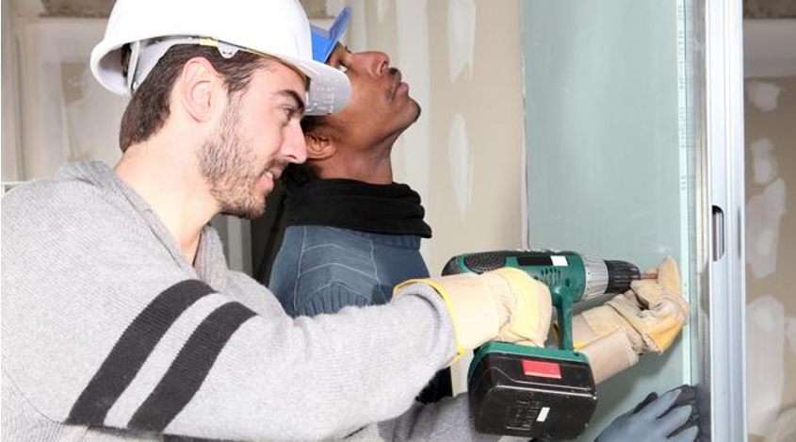
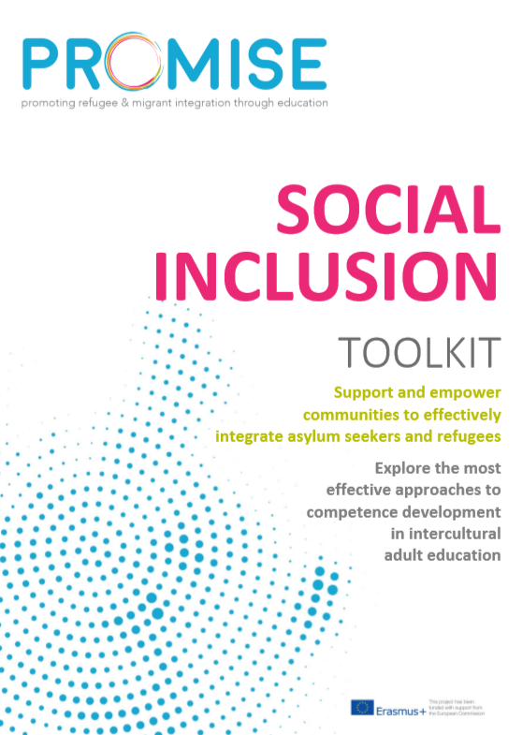
Germany - WILLKOMMENSLOTSEN (Welcome Pilots) Training Apprenticeships for Refugees
"Welcome Pilots" are designated staff in German chambers of skilled trades, chambers of industry and commerce, chambers of the liberal professions and other business organizations.
Their job is to support small and medium-sized enterprises in filling vacant training and job positions with refugees.
For more information on the
Welcome Pilots, check out page 11 of
Promise Social Inclusion Toolkit
In 2018, the Welcome Pilots facilitated more than 3,700 internships, 1,390 entry qualifications and over 1,220 employment places.

Slide 60
GOOD PRACTICE
Italy – “Diamond enterprise” to encourage business initiative among immigrants
The project has been promoted by the Region of Sardinia using the dedicated economic resources of the European Social Fund 2014-2020.
The beneficiaries are immigrants, including asylum seekers and refugees, who want to integrate into the economic and social fabric through the launch of a business initiative.
Selected people will be able to count on a series of supports, from a line of Microcredit to legal and marketing assistance for the two years following the birth of the company, to accompany the first steps of new economic initiatives.
The projects will welcome around 200 immigrants, selected from 600 applicants, to guide them to become entrepreneurs. At the end of the path it is estimated that there will be about forty business projects

Slide 61
Key Communication Takeaways/Action Points
Are you effectively using education as an integration/inclusion tool internally in your own organisation and in your provision of services/supports to others?
Adult Education Providers – consider the training topics on page 14. How many of these do you currently offer refugees/migrants/your community? Could you expand your offering?
Review our Innovative Teaching approaches. Which one of these could you bring into your service offering/education delivery?
Education and Employment offer tremendous opportunities for refugees and migrants. Could you promote these in your work or collaborations with others?
Source: https://oureverydaylife.com/the-importance-of-verbal-non-verbal-communication-5162572.html

