Slide 1

Getting Started:
Become an Agent of Inclusion:
Your Role as a Service/Education Provider

Slide 2
In this lesson, you will learn:
1.1 Introduction to Refugee and Migrants Inclusion
1.2 Understanding the challenges Refugees and Migrants face
1.3 Introduction to the PROMISE four strand approach to Inclusion
2.1 What is Agent of Inclusion? And why should you strive to become one?
2.2 Spotlight on Cultural Competence and Relationship Building
2.3 How our PROMISE Agents of Inclusion operate in Communities
INTRODUCTION
SPOTLIGHT ON AGENTS OF CHANGE
Learning Legend:
This project has been funded with support from the European Commission. This publication reflects the views only of the author, and the Commission cannot be held responsible for any use, which may be made of the information contained therein.
DOWNLOADS
USEFUL TOOL
GOOD PRACTICE
FUNDING OPPORTUNITY

Slide 3
INTRODUCTION
In this section:
1.1 Introduction to Refugee and Migrant Inclusion
Integration is a key term/concept frequently used across Europe when we talk about the resettling of refugees and migrants in their new host countries/communities.
But what is Inclusion? And why should service/education providers work towards it rather than integration? Before we answer these questions, lets learn more about what the terms refugee and a migrant.

Slide 4

Source: https://www.youtube.com/watch?v=25bwiSikRsI

Slide 5
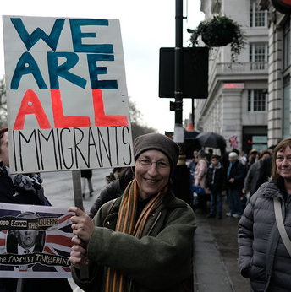
What is the difference between Refugees and Migrants?
Refugees are people who have been forced to leave their country in order to escape war, persecution, or natural disaster.
Migrants are people who make a conscious choice to leave their country to seek a better life elsewhere.
While each group leaves for different reasons, , without help and support they each can face disadvantage and exclusion in their new host countries/communities. For this reason, PROMISE focuses on both refugee and migrant inclusion.

Slide 6

Refugee and Migrant Inclusion
Refugee and migrant inclusion is a process which removes the barriers preventing these groups from becoming fully active members of society.
The focus of refugee and migrant inclusion is to promote and encourage refugees/migrants to participate in, and contribute to, the economic, social, cultural, civil and political life of the country they now reside in.
Our goal should is to help refugees and migrants become active and independent members of our societies.

Slide 7

Refugee and Migrant Exclusion
Now we know what Refugee and Migrant Inclusion is but before we can really promote/support it, we need to consider the ways in which refugees are excluded. They typically face exclusion in relation to:
Labour/livelihood
housing markets
community and social services
political participation
And crucially involvement in organizations which might give them a sense of identity or control over their own futures
GOOD PRACTICE : Have you considering involving refugees or migrants in your work/organisation? If not in a full time then perhaps a voluntary capacity? Inclusion is something we must practice as well as preach.

Slide 8
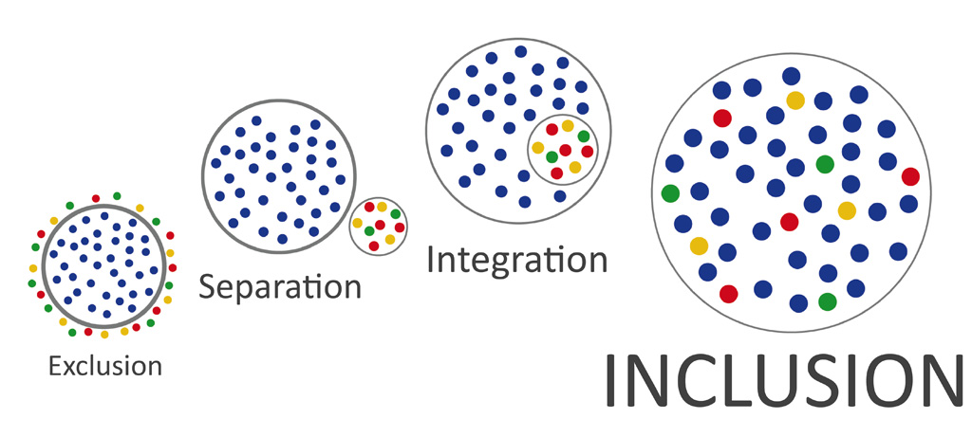
Integration is the crucial first step on the path to Inclusion
But Inclusion is the ultimate goal.

Slide 9
Why is Refugee Inclusion particularly important?
“We have a legal and moral obligation to protect people fleeing bombs, bullets and tyrants, and throughout history those people have enriched our society.”
—Juliet Stevenson, Actor and Amnesty Ambassador

Slide 10
INTRODUCTION
In this section:
1.2 Understanding the challenges Refugees and Migrants face and areas of support
Before you can make a meaningful change to the lives of refugees and migrants, you first need know and understand the challenges and disadvantages they face.
In this section, we look at these challenges and disadvantages. We also learn about the rights of refugees and areas where refugees and migrants receive support in our country.

Slide 11

Understanding the Refugees crisis..
“Refugees are mothers, fathers, sisters, brothers, children, with the same hopes and ambitions as us—except that a twist of fate has bound their lives to a global refugee crisis on an unprecedented scale.”
- Khaled Hosseini

Slide 12
Understanding the challenges and disadvantages faced by Refugees and Migrants
It is important to understand that refugees and migrants have many challenges and disadvantages facing them when they arrive in a new country/community.
Difficulties may be caused by:
isolation and a lack of knowledge about with systems and procedures in their host country
poor education or educational underachievement or the failure of the host country to recognise their foreign skills, qualifications and experience
lack of fluency in the host country language
cultural barriers and/or differences to that of the host society

Slide 13
Things to know before you start providing services for Refugees and Migrants
May have health issues or may have suffered severe trauma.
Coaching on how to work with those who have experienced trauma should be sought by all service providers starting to work with refugees
May feel socially excluded from their new/ host communities
May have language/education difficulties/differences.
Adult may have very different levels of past education – education may have been interrupted for some, while others may be very highly educated
May have ethnic, cultural, political or religious differences to their new/host countries

Slide 14

Impact of challenges and disadvantages on Refugees and Migrants
These disadvantages can create lack of confidence, lack of self-esteem and low aspirations for refugees in their new countries
These disadvantages also permeate into all aspects of the refugees life in their host country – inhibiting them from active participation in their communities to entry into the labour market.

Slide 15

Spotlight on Refugees Rights
The UN Refugee Agency is a global organization dedicated to saving lives, protecting rights and building a better future for refugees, forcibly displaced communities and stateless people. They provide clear guidelines on the rights of refugees:
A refugee has the right to safe asylum. Refugees flee because of the threat of persecution and cannot return safely to their homes in the prevailing circumstances.
Refugees should receive at least the same rights and basic help as any other foreigner who is a legal resident, including freedom of thought, of movement, and freedom from torture and degrading treatment.
Economic and social rights are equally applicable. Refugees should have access to medical care, schooling and the right to work.
Source: https://www.unhcr.org/en-ie/publications/brochures/3b779dfe2/protecting-refugees-questions-answers.html

Slide 16

In what areas are refugees supported in Ireland?
Refugees receive support from a wide range of public, private and volunteer services.
Accommodation and Welfare
Medical Services
Education
Refugees have the right to accommodation and welfare. In Ireland, this is provided through direct provision centers which provide free food and shelter. Refugees also receive a daily allowance.
Refugees have the right to support from the medical services. In Ireland, refugees and asylum seekers are entitled to medical services free of charge
All children and young people, are entitled to free primary and post primary education in Ireland. Refugee Adults also have access to some free education (adult literacy, English language classes etc.)
Source: https://www.citizensinformation.ie/en/moving_country/asylum_seekers_and_refugees/services_for_asylum_seekers_in_ireland/direct_provision.html

Slide 17
In what areas are refugees supported in Ireland?
Refugees receive support from a wide range of public, private and volunteer services.
Work/Employment
Interpretation and translation
Localised Supports
Refugees and asylum seekers can apply for permission to work and access employment and self-employment. Permission to work once granted is valid for 6 months and is subject to renewal
Refugees have the right to interpretation and translation services which are provided where necessary.
Refugees also receive localised supports with regard to local orientation, community integration and more.

Slide 18
How do supports for Migrants differ?
Migrants will generally use mainstream services provided by governments, community organisations and the private sector to address a number of their settlement needs.
There are also a number of key organisations who work with migrants to help them resettle:
Immigrant Council of Ireland an independent, national organisation which supports migrants coming to Ireland for purposes such as work, study, family reunification, self-employment or to visit.
Migrant Rights Centre Ireland is a national organisation providing support to migrant workers and their families. It encourages migrants to get involved in their community and actively participate in all levels of society.
Foreign embassies and consulates provide consular services to nationals of their country.

Slide 19
INTRODUCTION
In this section
1.3 Introduction of PROMISE four strand approach to Inclusion
To be successful, the principles of inclusion needs to permeate all areas of the refugee and migrant life in their new/host country.
For the purposes of the PROMISE project, we have broken our approach to inclusion down into four strands. In this section, we provide an overview to these strands and the learning content you will find in the rest of the accompanying PROMISE Agent of Inclusion learning materials.
Language and Communication
Civic Life, Culture and Community
Education and Enterprise
Wellbeing and Family

Slide 20

LANGUAGE AND COMMUNICATION
Language has a key role to play in the integration of adult refugees and migrants as do your communication skills as a key service/education provider and agent of inclusion.
Strand one of our PROMISE training will help you to consider different ways you can introduce language learning to refugees and migrants. It will also provide some insights to help you improve your intercultural communication skills/approaches.

Slide 21

CIVIC LIFE, CULTURE AND COMMUNITY
Refugees and migrants have a key role play in their new communities and as service/education providers, there are many things we can do to help them.
Strand two of our PROMISE training introduces a number of key concepts including social integration and inclusion. We look at ways to empower refugees and migrants to become community champions as well as programmes which can be introduced to help make our communities more inclusive.

Slide 22

WELLBEING AND FAMILY
Having fled persecution and/or war, the lives and families of Refugees have been turned upside down. Migrants too face difficulties being away from home and often feeling alienated and alone.
Strand three of our PROMISE training looks at the themes of wellbeing and family and suggests areas where service/education providers can provide support. Key areas include working with refugees and migrants to build their resilience, confidence, self-esteem and as well as a sense of purpose.

Slide 23

EDUCATION AND ENTERPRISE
Education is a key integration/inclusion tool and one which can be used to unlock the potential and futures for refugees and migrants in their new countries.
Strand four of our PROMISE approach to inclusion examines Adult education as an integration tool and how service/education providers can start to create/tailor training programmes to refugees and migrants. We also explore the theme of enterprise and learn about how/why refugees and migrants are one of the most entrepreneurial groups in European society.

Slide 24
AGENTS OF INCLUSION
In this section:
2.1 What/Who is an Agent of Inclusion?
An Agent of Inclusion is a changemaker who takes responsibility for the inclusion and wellbeing of everyone in their community. In the context of PROMISE, we will look solely at Agents of Inclusion who work with refugees and migrants.
Agents of Inclusion are usually the service/education providers who are most active in grass roots community development and the provision of social/education services.

Slide 25

What/Who is a Agent of Inclusion?
An Agent of Inclusion is a changemaker who takes responsibility for the inclusion and well-being of everyone in their communities – particularly those on the margins of society.
From an organisation point of view, Agents of Inclusion are usually the service/education providers who are most active in grass roots community development and the provision of social/education services.
These organisations may be public, private, voluntary or charitable entities. Each has a key role to play in the inclusion process.

Slide 26
What work does the Agent of Inclusion do?
Typically their work involves elements of the following:
Facilitation - bringing communities together
Orientation – welcoming of new groups (eg refugees and migrants)
Education – to promote diversity in communities and ensure equal opportunities for all
Celebration – support for public events that celebrate multiculturalism and inclusive community ideals
The work of the Agent of Inclusion is part education, part inspiration, part motivation and part mobilization.

Slide 27

Are you an Agent of Inclusion?
Or would you like to be?
Could you or your organisation could be an Agent of Inclusion?
Do you have some skills or expertise in this area that you would like to build on?
Take our Agent of Inclusion Quiz to find out your skills/strengths in the area of Inclusion - http://www.quiz-maker.com/QD94DOG
INCLUSION

Slide 28
AGENTS OF INCLUSION
In this section
In this section, we introduce some of founders of the PROMISE project who have gone through the process of becoming Agents of Inclusion.
We review some of the work they have undertaken which has been inspired by the PROMISE project.
Importantly, we focus on how this work has created lasting impact for the adult refugees/migrants and host communities where they live.
2.3 How our PROMISE Agents of Inclusion operate in their Communities

Slide 29

Roscommon Leader Partnership - Ireland
Local development organisation involved in the resettlement of refugees in County Roscommon. RLP promotes inclusion and integration through a number of key programmes and events:
County Roscommon Refugee Resettlement Programme
Education and Training in conjunction with Galway Roscommon Education and Training Board
Intercultural Events and Celebrations

Slide 30
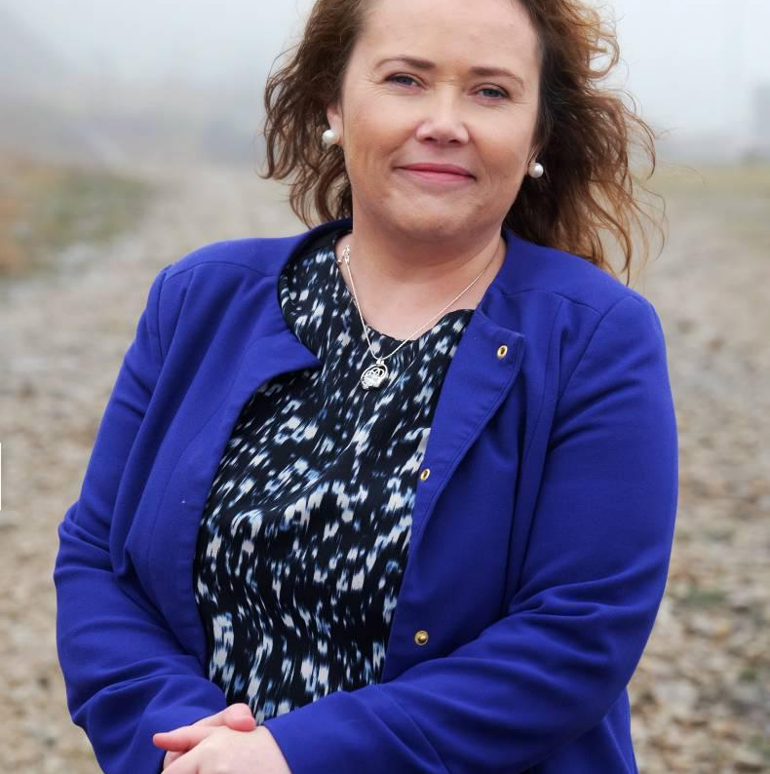
Martina Earley, Roscommon Leader Partnership - Ireland
“In March 2017, we welcomed our first Syrian refugees to County Roscommon at the Emergency Reception and Orientation Centre in Ballaghaderreen. RLP, Tusla, and the County Childcare Committee worked collaboratively and levered central funding for the provision of early years’ education for the Syrian families.
I believe that Education is a tool which can achieve the economic integration of migrants and refugees and in turn regenerate the local community both spiritually and economically.”

Slide 31
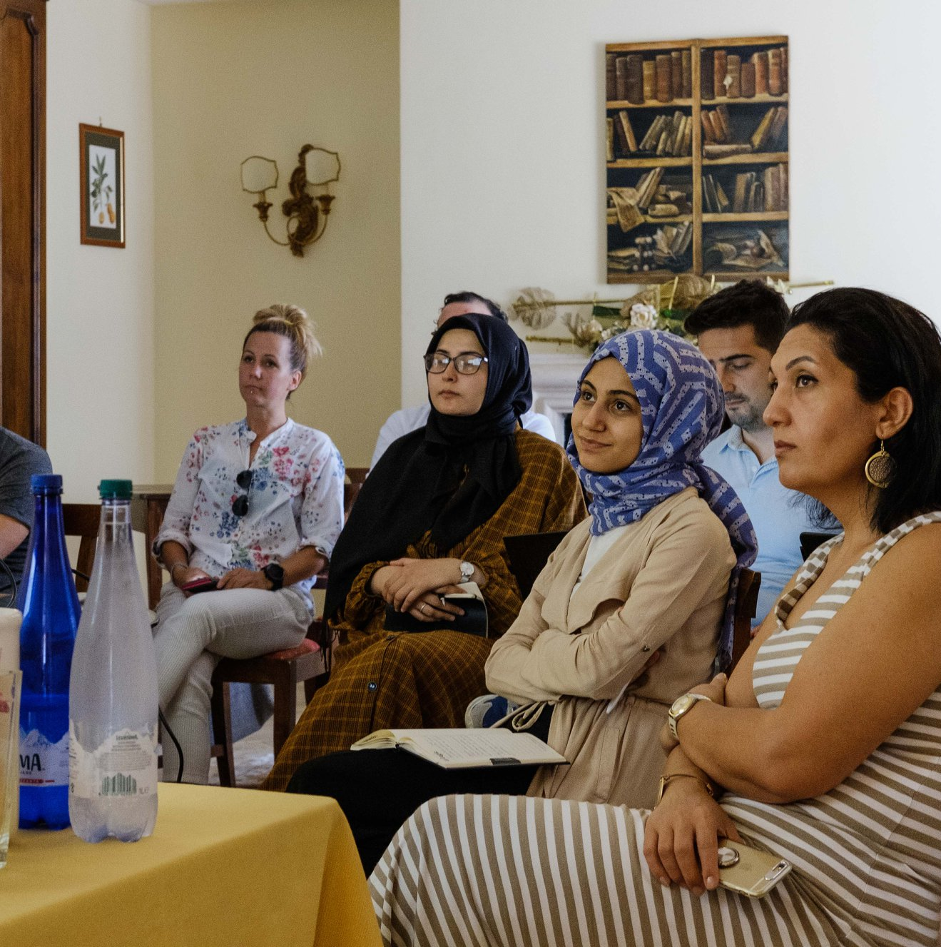
Momentum,
Ireland
Momentum is an Irish VET organisation which champions inclusive education in their work to reach, teach and impact marginalised target groups.
MMS are key delivery agent in Just Creative a training model which uses hand craft as a platform for personal development, pre-employment, training & integration support provision within the Syrian Female Refugee Community in EROC Centre, Ballaghaderreen.
They are also involved in European inclusion and integration initiatives such as www.inclusion.how

Slide 32

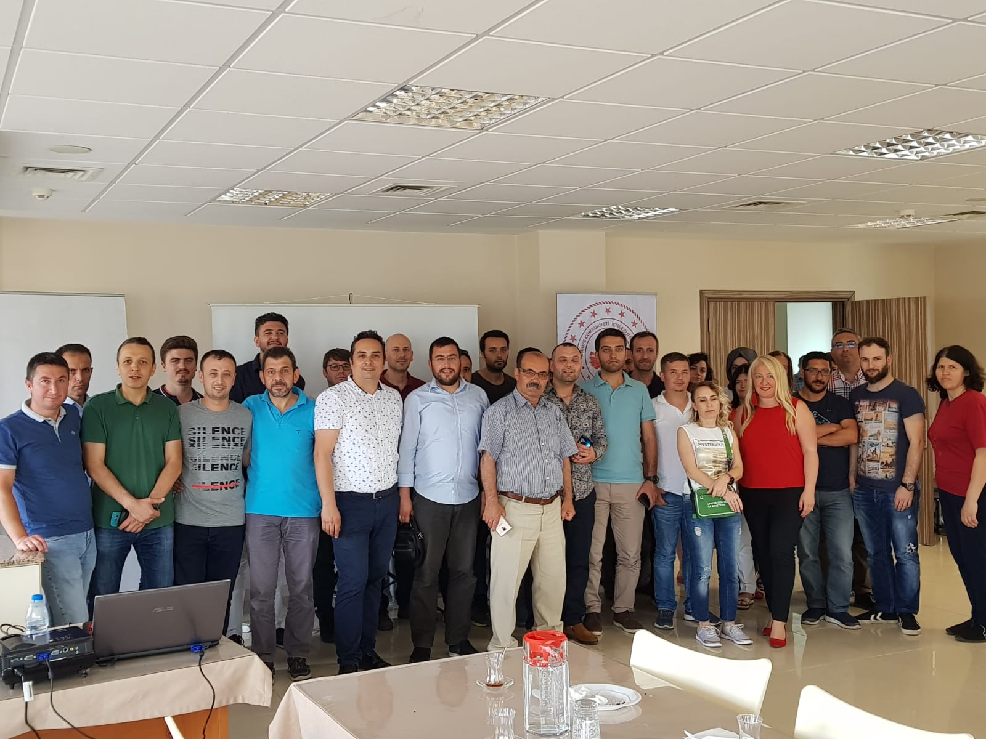
Tuzla Kaymakamlığı - Turkey
Tuzla Kaymakamlığı is a public authority responsible for governmental and administrative issues in Tuzla, Turkey.
TUZLA is advancing the inclusion and integration of refugees through a number of key programmes and events such as the Teaching the Language to Refugees and Migrants Conference and the Social Inclusion of Migrants and Refugees via Vocational Education and Training (VET)

Slide 33
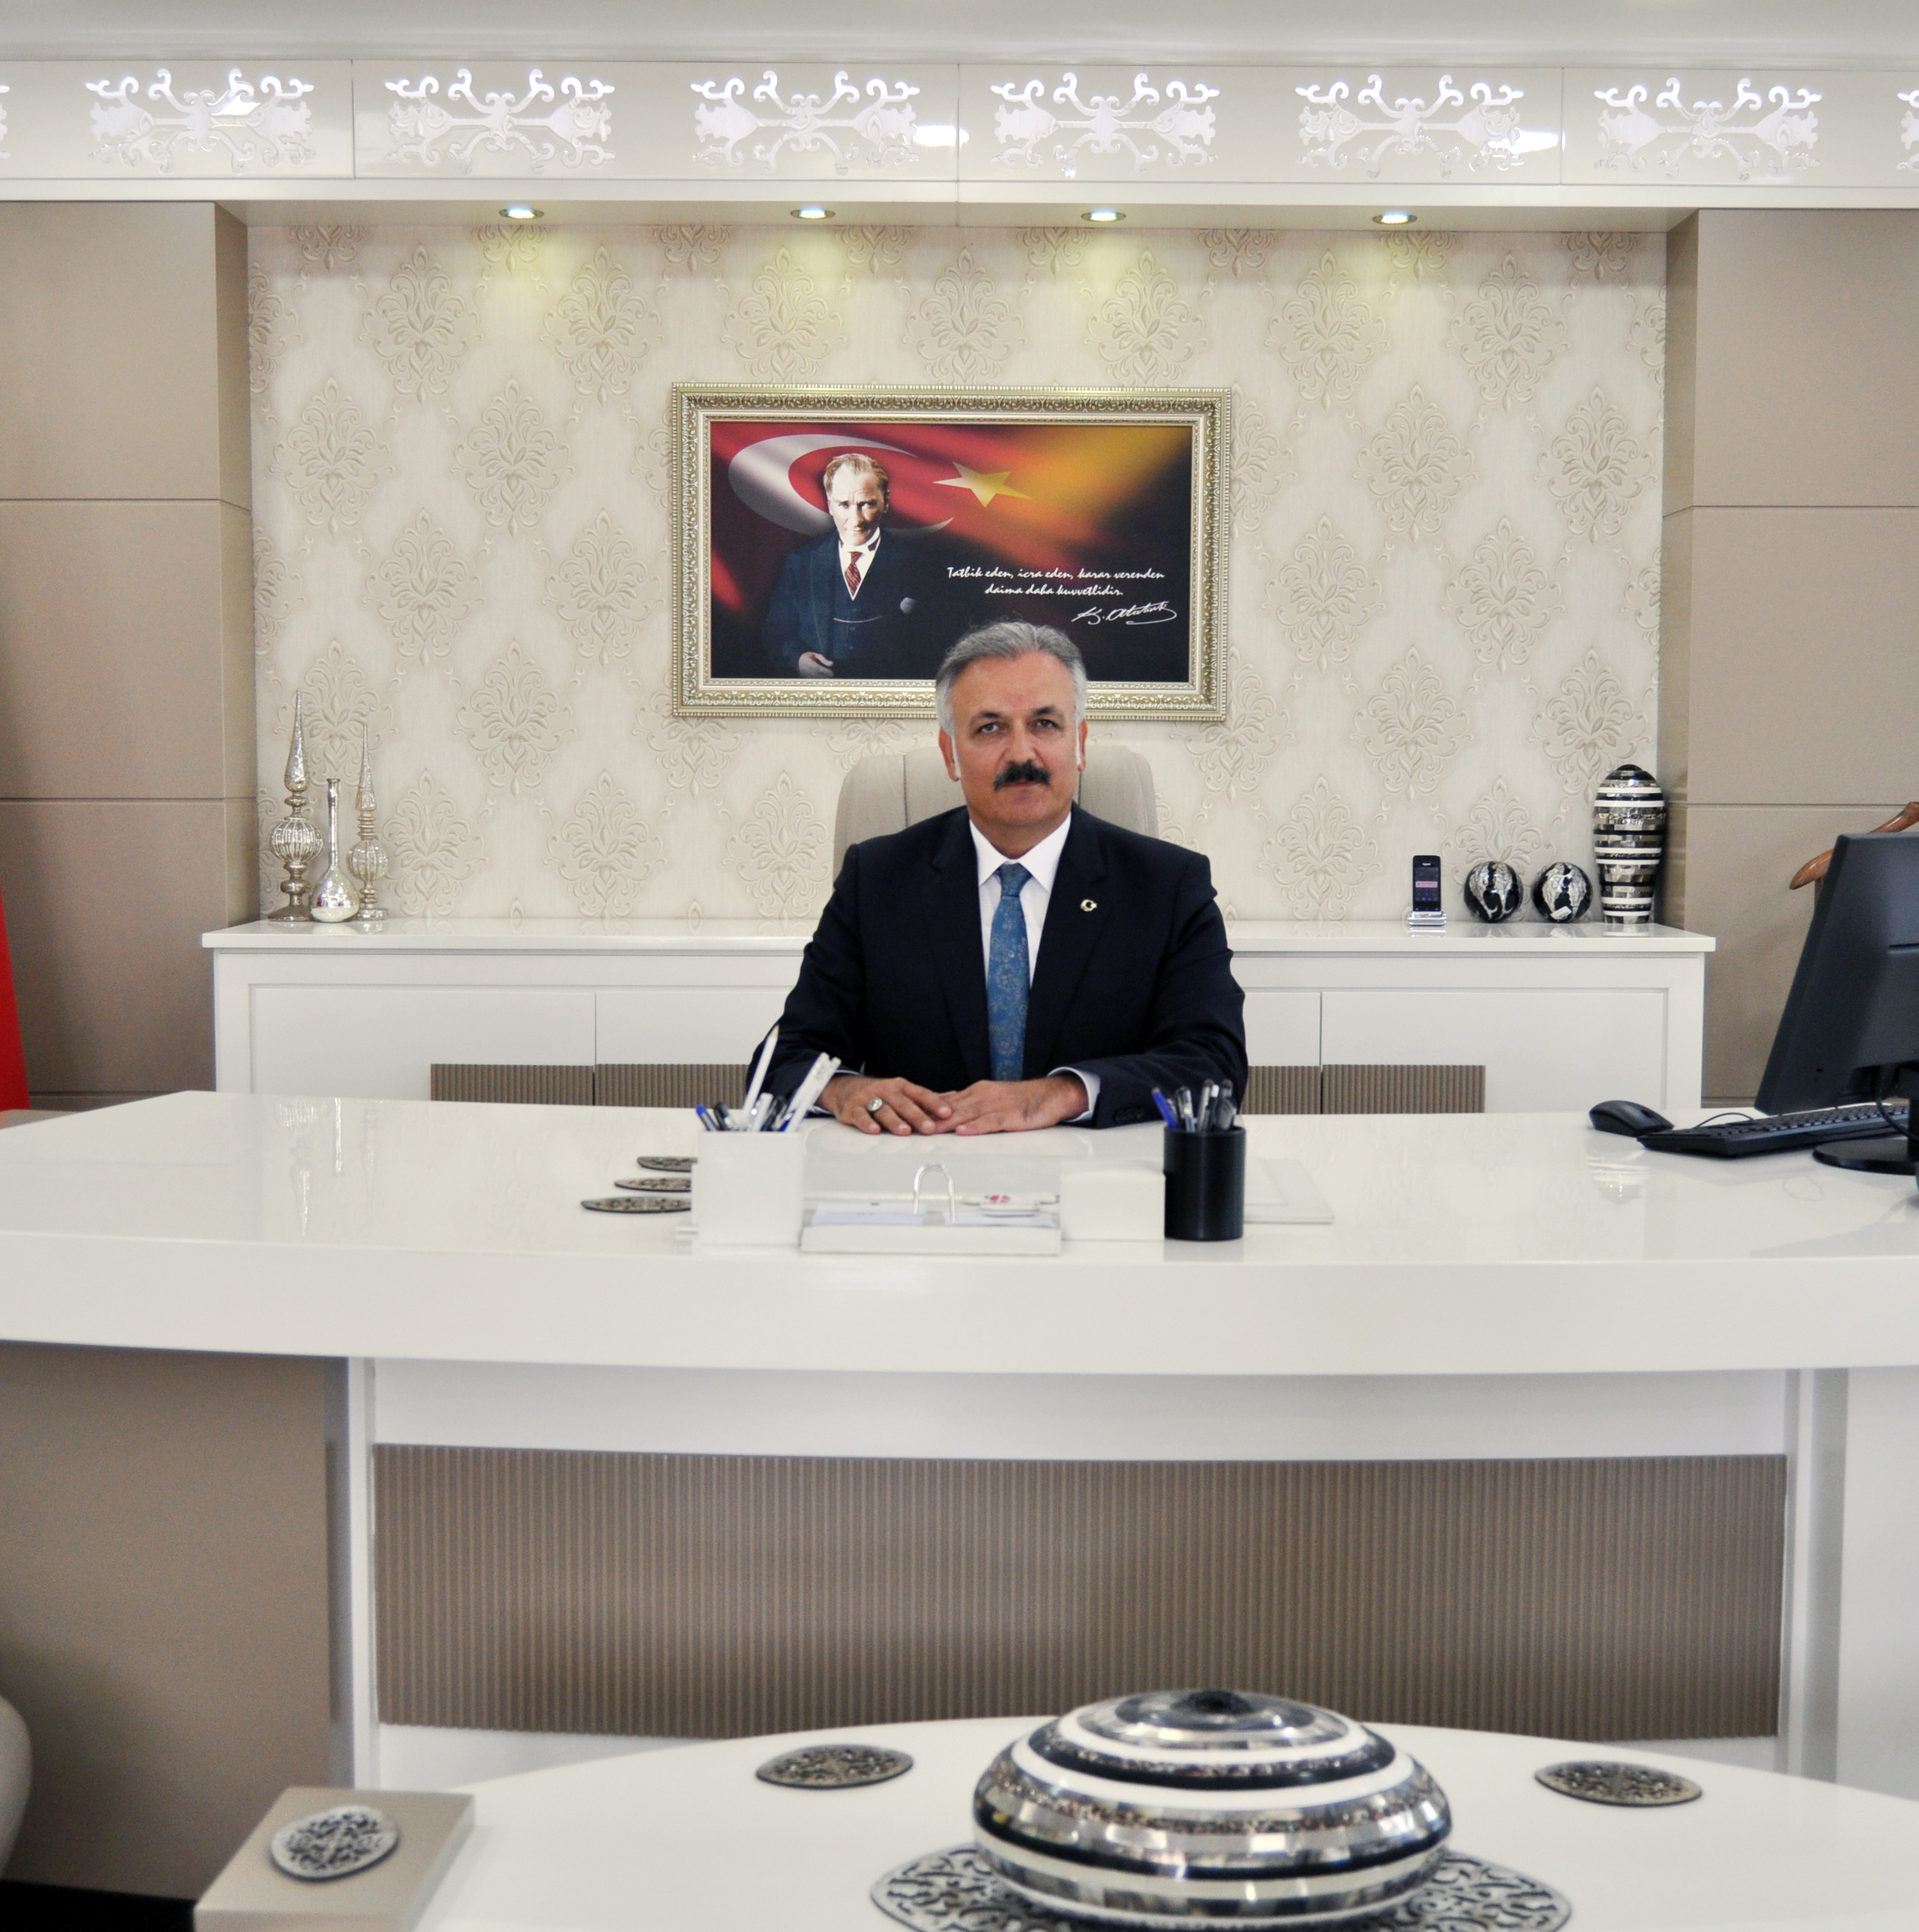
Ali Akça
Tuzla District Governor, Turkey
“Tuzla Kaymakamligi (District Governorship) is proud to play a leadership role in addressing the Syrian refugee crisis in our local area in which 3252 registered refugees are hosted.
As the main public authority in our region, we governs all social, economic, sheltering, security, educational and health support of these refugees settled in Tuzla.”

Slide 34

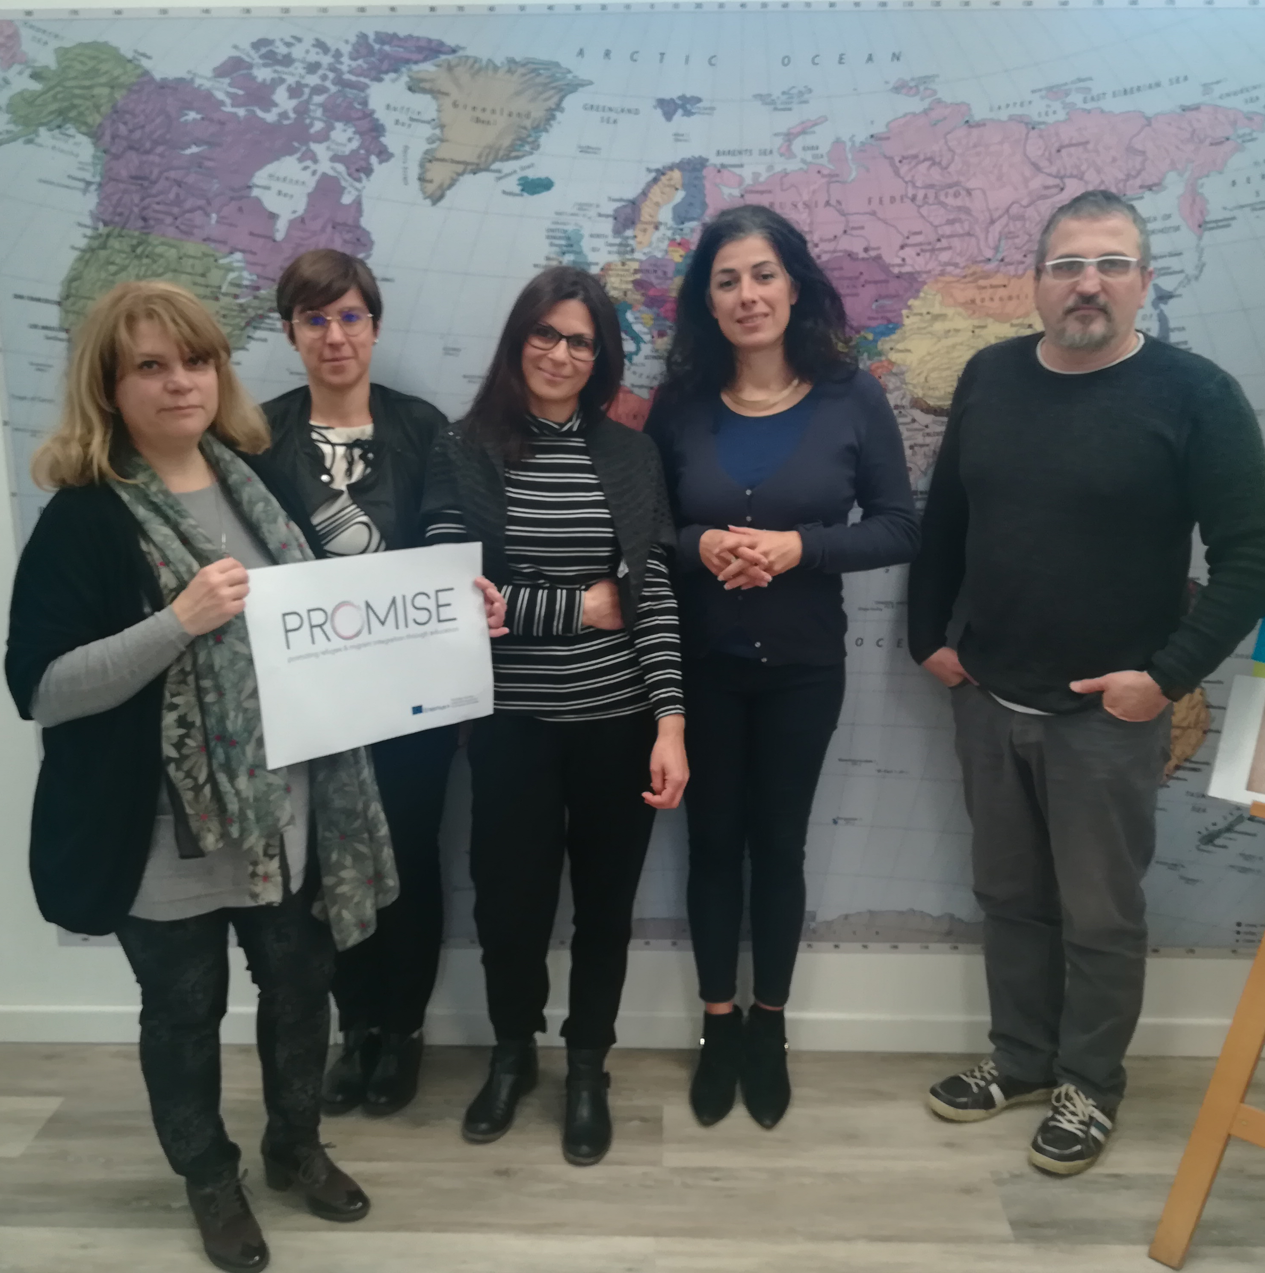
Frontera Lavoro - Italy
Frontera Lavoro are a social cooperative working to increase the employability of vulnerable groups including refugees and migrants. As an Agent of Inclusion they are involved in:
Integration of Migrants with Co-designed Territory Policies and Actions
Language skills for social inclusion
Accessibility and Inclusion for Migrants in Vocational and Adult Education

Slide 35


KulturLife –
Germany
KulturLife is an non-profit organization that promotes intercultural exchange. As an Agent of Inclusion, they practice what they preach and have inclusion at the heart of their organisation. Key programmes include:
Integration of Refugees into the KulturLife work force
Intercultural Events and Youth Exchanges
Social inclusion of migrants and refugees into the VET sector

Slide 36

Chiara Dickmann, KulturLife - Germany
“Our inter agency network is key to our inclusion work. It consists of public, private and non-profit organization, giving us the opportunity to work with relevant stakeholders with whom we would not have come into contact in the first place.
Cooperation at different levels is also important in order to work together and unite efforts for the most effective and efficient ideas and solutions.”

Slide 37

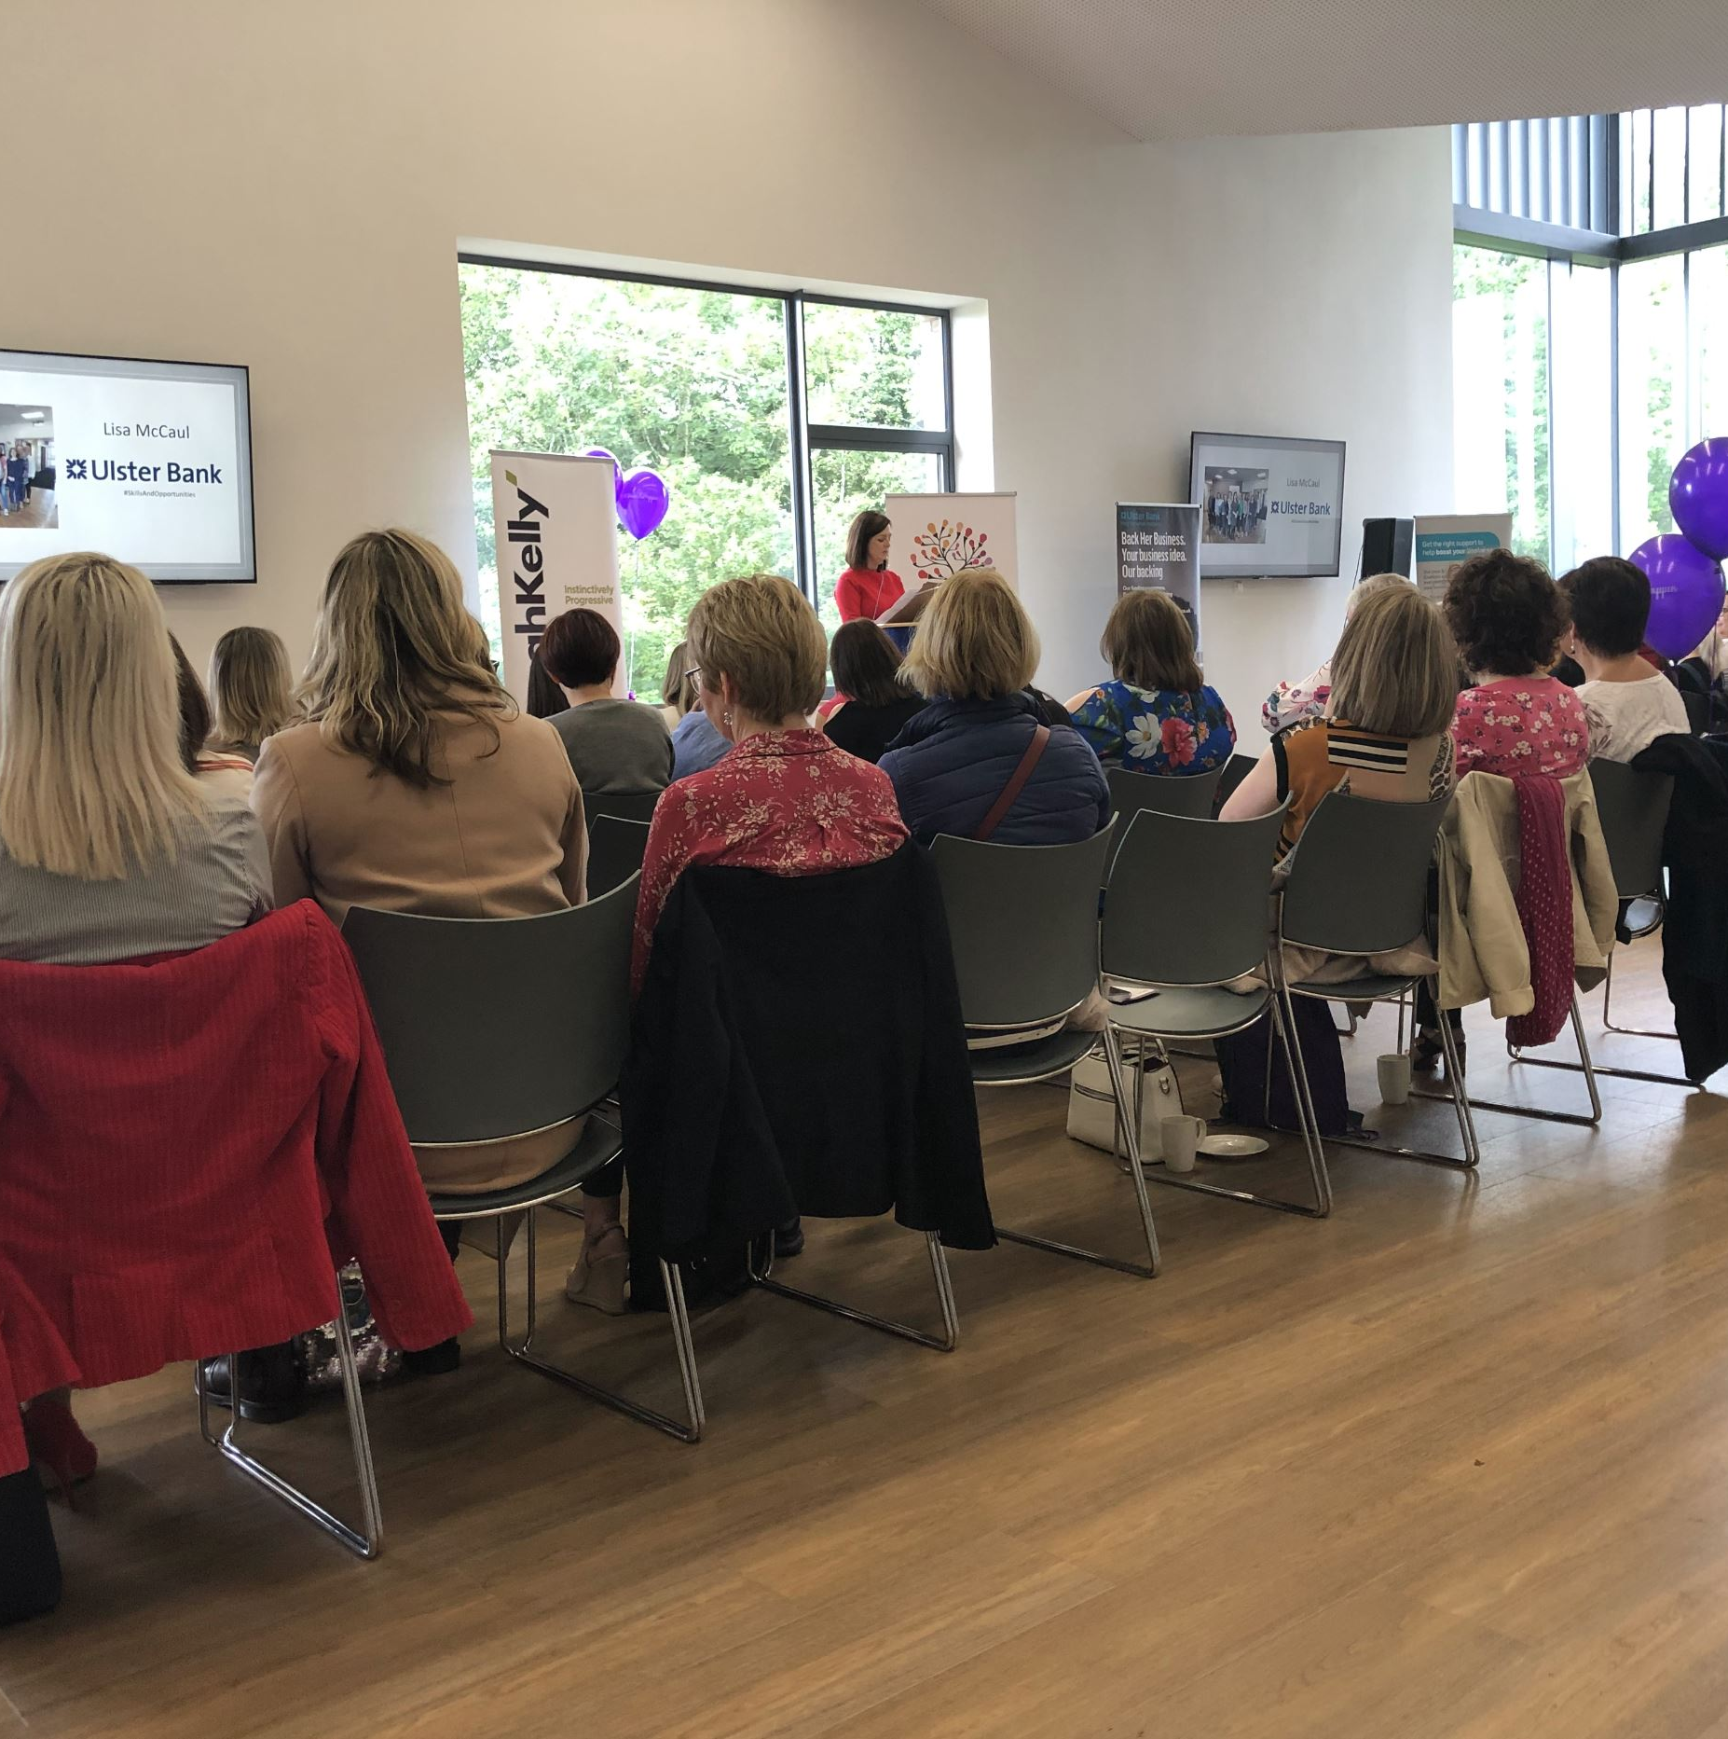
Canice Consulting,
Northern Ireland
Canice Consulting is a small, outward looking company that specialises in vocational training and innovation support for regional development initiatives.
The team at Canice Consulting have over 20 years of experience in the promotion of inclusion education with many programmes developed and delivered to help promote the inclusion and integration of refugees.

Slide 38


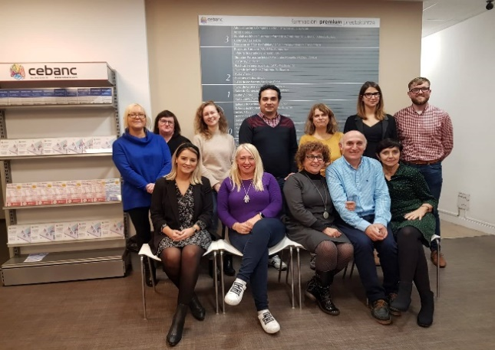
CEBANC
Cebanc is a leading education centre in San Sebastian known for the quality of its teaching, facilities and high levels of employability of its students. Established in 1978, over 50,000 students have trusted their professional education to Cebanc over the years.
Cebanc is at the forefront of providing education and opportunities to disadvantaged and hard to reach groups and has a very strong migrant student base with learners form Africa, South America.

